Slide 1
Cross-node Memory as a Linux Storage Tier：Exploring POSIX-based Shared Memory
Yifan Qiao
qiaoyifan4@huawei.com
Notes:
Good afternoon, thanks for coming for this session. My topic is cross-node memory as a Linux storage tier. We expose pooled DRAM through a POSIX filesystem. The rest of the talk is how that pool is assembled, and what Linux can do with it.

Slide 2
Content
Motivation
Design
Prototype
Future
Notes:
The topic has Four parts. what we saw, how XMFS is built, what we measured, and what is next.
For a long time, extra memory on a server was local, or it was a network filesystem. The interconnects like CXL, and Unified Bus make a third thing possible: memory that more than one machine can actually touch.

Slide 3
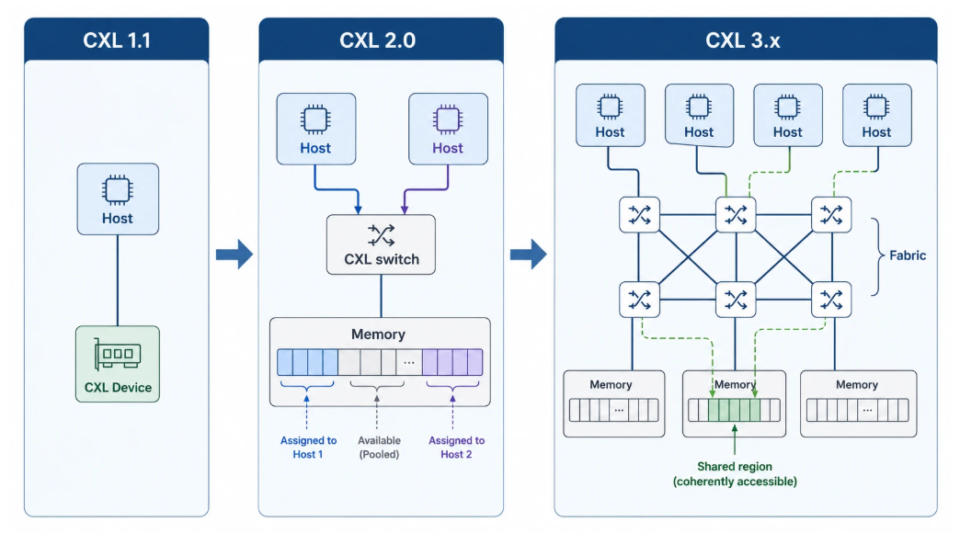
CXL 3.0 pooling & sharing
CXL went from point-to-point, to switched pooling, to a fabric that can share memory.
Notes:
First is CXL
So CXL 1 already puts .io, .cache, and .mem on the same PCIe link. It doesn’t support switching or pooling — It just sticks an accelerator or some extra memory next to the CPU.
Then CXL 2 adds a single-level switch, and support pooling. the memory still comes from the CXL device, not from each server’s own DRAM. You can cut that device into pieces and give piece A to host A, piece B to host B. Each piece is exclusive. Two hosts are not looking at the same bytes.
CXL 3 is where it becomes a fabric that can actually share memory. And That is the opportunity.

Slide 4
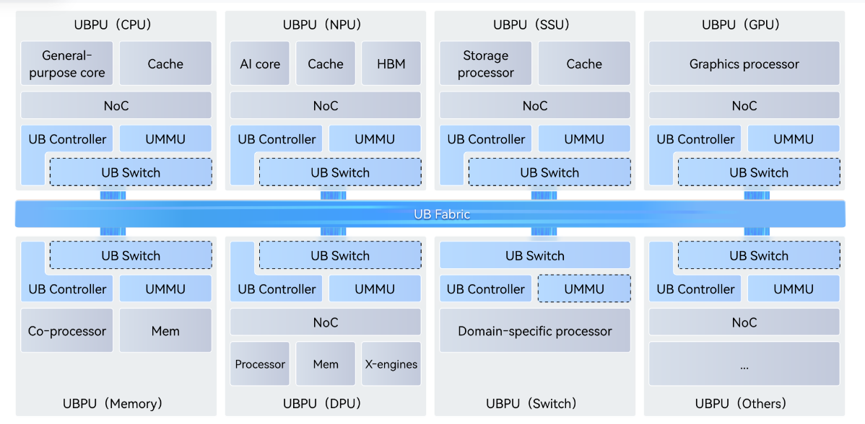
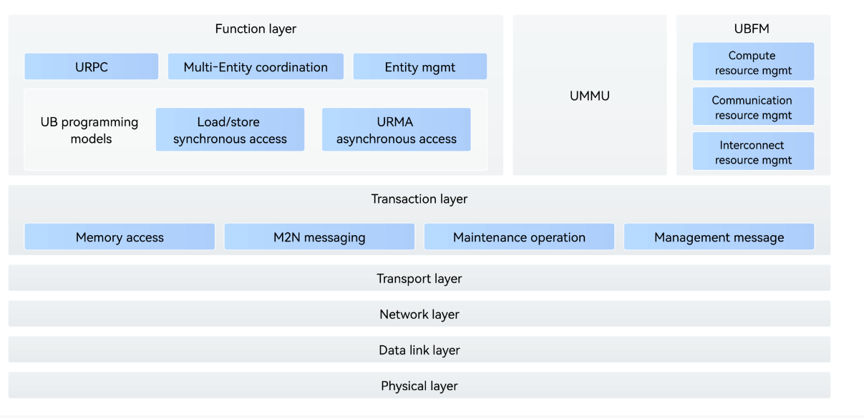
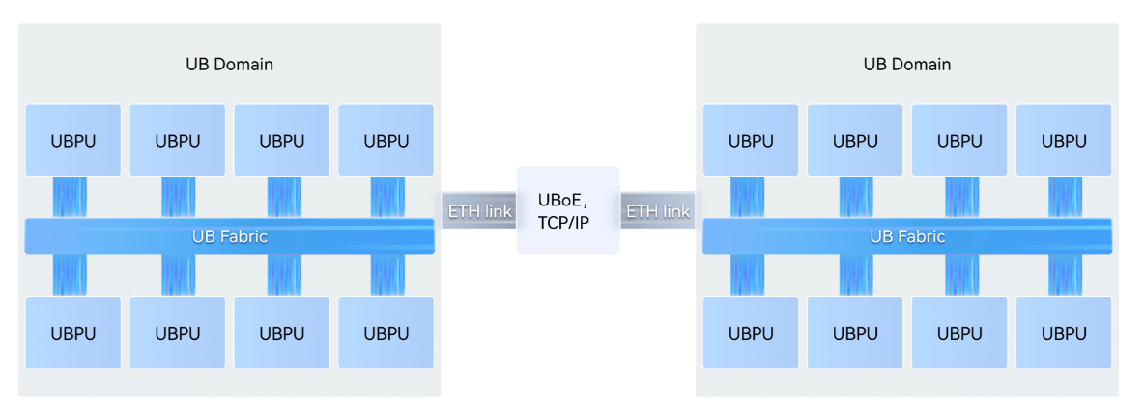
UB mesh
UB domain
UB protocol stack
Unified Bus Sepc: https://www.unifiedbus.com/en
UBRT: https://www.unifiedbus.com/static/UB-Root-Table-Spec-1.0-en.pdf
Cross-UB domain
Notes:
If CXL is “a link that grew into a fabric,” UB is more like “we built the whole stack around that fabric.”
Start on the left, the protocol stack. At the bottom it looks familiar: physical, link, network, transcations, transport.
On top of that is the programming model. Synchronous is load/store. Asynchronous is URMA, Unified Remote Memory Access. You can consider it as the RDMA-shaped: you register a region, import a remote one, and read or write without the other CPU sitting in the middle.
The middle picture is a UB domain. CPU, NPU, GPU, memory, storage, DPU — each is a UBPU on the same fabric. Each has a controller, an UMMU, and a switch into the bus. This is the single-node story: it is not one extra DIMM beside a CPU. The box is already a pool of compute and memory.
The right picture is the cross-node story. Between domains, it is UBoE, or Ethernet and TCP/IP.
Two links are on the slide if you want the documents later. The Unified Bus spec, and UBRT — the root table.
The software is not only a diagram. Firmware, drivers, pooled-memory management exist. The source is already released. It is not in mainline yet. We want to take it upstream.

Slide 5
Memory pooling and sharing today
CXL
remote DRAM becomes byte-addressable
memory semantic ld/st + optional network semantic
memory sharing usually assuming hardware CC
UB
1. treat it as slow RAM: NUMA, memory tiering, CXL-as-RAM
need hardware CC
no POSIX namespace acorss kernels
Linux
2. treat it as network storage: NFS...
DRAM is only a buffer/cache
multiple copies on the path
3. treat it as DAX: FAMFS, DAXFS...
what we want: pooled DRAM as a POSIX medium, without assuming hardware CC
what we want: pooled DRAM as a POSIX medium, without assuming hardware CC
Notes:
So the fabric supports pooling and sharing. Remote DRAM is byte-addressable. Sharing a cache-line usually assumes hardware cache coherency.
Linux today uses that in three ways.
First: treat it as a slower RAM. Like NUMA, memory tiering, CXL-as-RAM. You need hardware cache coherency, and you still do not have one file tree across kernels.
Second: treat it as network storage. Like NFS family. DRAM is only a cache. Still needs copy on the IO path, and it’s slower than the memory-semantic path.
Third: treat it as DAX. There are some works on it. Those designs typically still sit on one shared device, or they need one coherence domain.
What we want is the missing combination: the pool is the POSIX medium, and we do not assume the machines share a coherent cache.

Slide 6
XMFS(eXpress Memory FS): Core insight
CXL and UB make memory sharing possible. XMFS can sit on a concentrated pool (one disaggregated device) or on an aggregated pool (each node contributes local DRAM).
Two data modes:
  In one hardware CC domain: LD/ST. mmap is cache-line access to the pool (zero-copy after map). Nodes communicate through a MPMC message ring in shared memory.
  Without hardware CC, or when CC is too expensive:Network mode. Remote read/write does not depend on cache-line flush; the cost is extra copies versus LD/ST. This path does not need a coherent address space.
Notes:
XMFS stands for eXpress Memory File System.
The pool can be disaggregated Or assembled. for the later one, each node contributes its own DRAM. XMFS support both.
We do not assume those nodes are in one cache-coherent domain.
If they are, we use the ld/st path: after mmap you are touching the pool directly, and it’s zero-copy. We designed the control plane using a MPMC message ring in shared memory
If they are not — or CC is too expensive — we do not pretend atomics still work or work efficiently across the fabric. We designed to use network mode, in UB it’s Unified Remote Memory Access. Like traditional network mode, XMFS also needs extra copies through a bounce buffer between two cache-coherence domains.

Slide 7
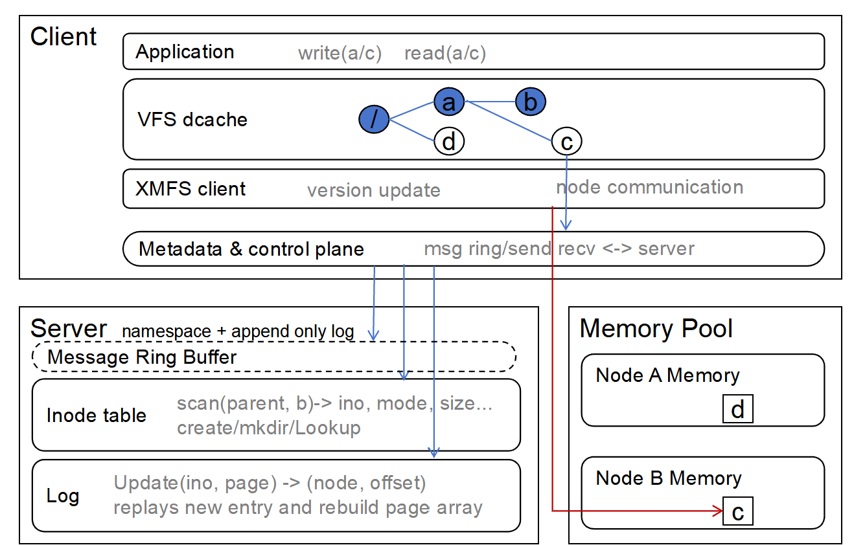
XMFS Architecture: A DFS-like kernel filesystem
Server handles metadata and space allocation
superblock(version control)
inode table
append-only log slot allocation
load balance
Client handles POSIX request and communicates to server and memory pool
replay to catchup
build inode table
write logs
Memory Pool, usually the clients’ memory, also a disaggregated device
hold data
allocate data slots
GC
Notes:
This is the architecture. It looks a bit like a distributed FS, but the medium is the memory pool.
The Server handles metadata and space placement. including, Superblock, the inode table, log-slot allocation and load balance.
The Client handles POSIX requests. It catches up by replaying the log, rebuilds its inode view, and appends UPDATE logs.
The Memory Pool holds the data, allocates data slots, and does GC. Usually that memory is on the clients themselves. It can also be a disaggregated device.
When a node mounts, the Server records how to reach that node’s memory — recording address and a remote key if using network mode, same idea as RDMA. Other nodes read that from the superblock and can import the pool.
Here is an example of write and read.
Process on A writes /a/c. The client first catches up. Then it posts a request: for ld/st mode, posts into a multi-producer message ring the Server is polling; for the network mode, it’s a send request the Server receives. The Server reserves a log slot and names a memory node. The Server has load-balances, it checks the usage of each memory node and choose the memory node with the most free space. After that the client talks to that memory node directly and writes the bytes. Then it fills the log slot: with file, page, node, offset information. The Server never moves the file data.
for a read on B. The client looks at the superblock version and the inode-table version. If it is behind, it syncs inodes and replays new log records. Now it knows the bytes sit on a memory node, and it reads the current version from that node.
On top we could stack another overlay-like filesystem. so hot data stays in the pool and cold data goes to local disk. And persistence is guaranteed.

Slide 8
XMFS Spec
Scale: 16 clients (and memory nodes) in this prototype.
Metadata lives on one Server (namespace + log slots). Data pages are allocated by the pool owner.
Network mode only supports URMA now. RDMA is not in this tree.
Writes are out-of-place (log-structured / COW): a write allocates new pool pages; readers keep the old mapping until they catch up. Per-owner GC reclaims.
Ordinary filesystem POSIX operations are supported.
 | Ops
File | open / read / write / lseek / mmap / fallocate / getattr / setattr
Directory | create / lookup / mkdir / rmdir / readdir / rename / link / unlink
Other | symlink / mknod / xattr (user / trusted / security) / statfs
Notes:
Here is the constraint
This prototype has maximum 16 clients, along with memory nodes.
Metadata lives on one Server. Data pages are allocated by the pool owner. Reclaim is local. The node that owns the pages runs GC on its own memory. There is no fabric-wide free map.
Writes are out-of-place — XMFS is log-structured and uses COW. A write allocates new pool pages. Readers keep the old mapping until they catch up. That is how we tolerate a stale reader when concurrent operations happen.
And Ordinary filesystem operations are supported.

Slide 9
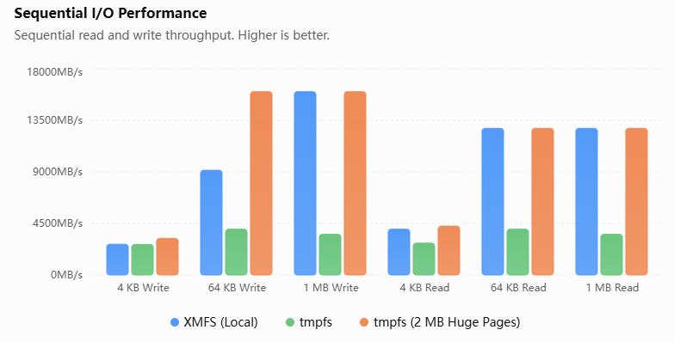
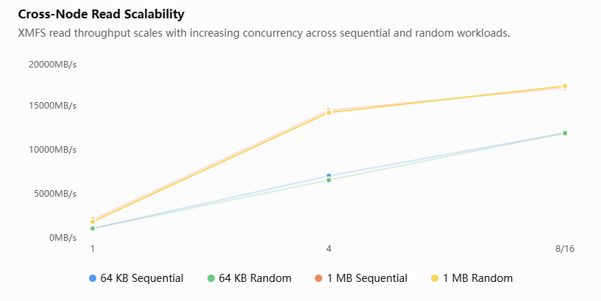
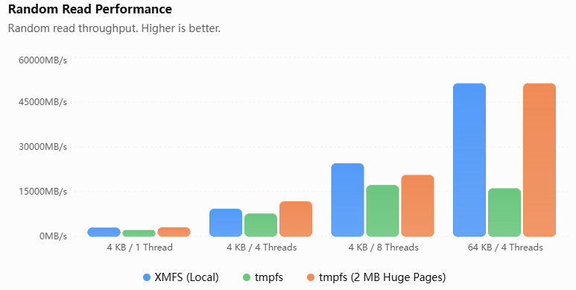
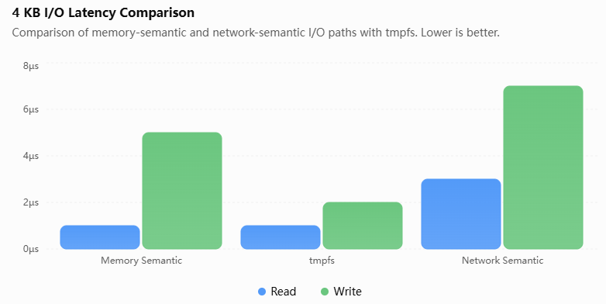
Basic performance
Notes:
Here are the microbenchmarks
Left are the local ones. Blue is XMFS on one node. Green is tmpfs with the usual 4Kilobyte pages. Orange is tmpfs with 2 megabyte huge pages.
Against default tmpfs, we are clearly faster when the I/O gets past 4Kilobyte. no matter sequential or random. The reason is the 4Kilobyte tmpfs path has more faults, more page-cache work. XMFS puts the bytes into the pool directly.
creating ten thousand files is also faster than tmpfs.
Against 2 megabyte tmpfs, only 1 megabyte sequential read and write have the same performance. Huge pages cut TLB misses, XMFS uses io size to read/write.
right are across nodes. Throughput goes up as you add threads. If the iosize is same, Sequential and random are close to each other, .
In the latency chart, memory semantic is in the same microsecond range as tmpfs. The other path is a few microseconds more.

Slide 10
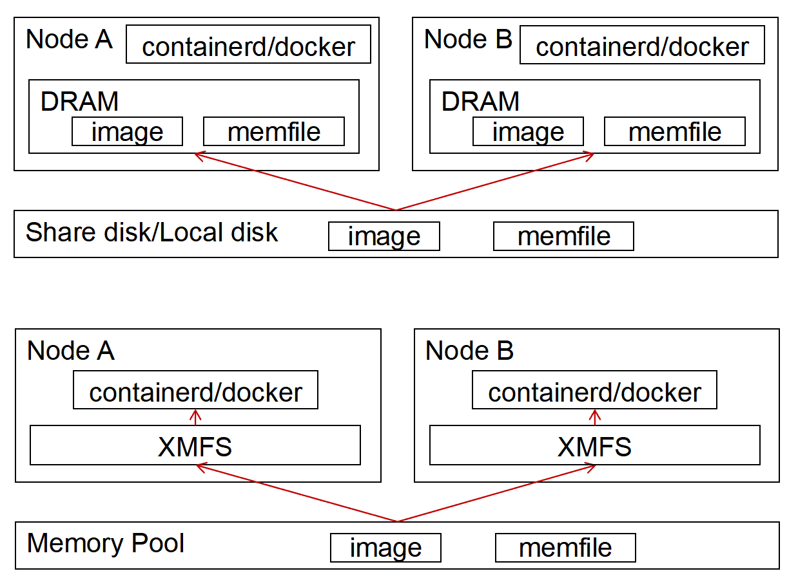
Prototype: container cold start
Read-only image share
Nodes boot the same container image. Today each node reads a local copy from disk.
XMFS keeps one image in the pool. Both nodes open the same file and LD/ST the layers — no second pull.
3.25 s -> 1.99 s vs local disk
Notes:
And XMFS was already used in some actuall jobs.
The first is container cold start.
There are a bunch of machines. They all need to start some containers. Today each machine reads that image from its own disk. for example, if using five nodes, there are five copies, and each nodes’cold start needs to access the disk again.
We put the image in the pool once. Each node opens the same file and reads it from share memory. Nobody pulls a second copy.
XMFS is 40% faster than the normal path. mainly from the start time.

Slide 11
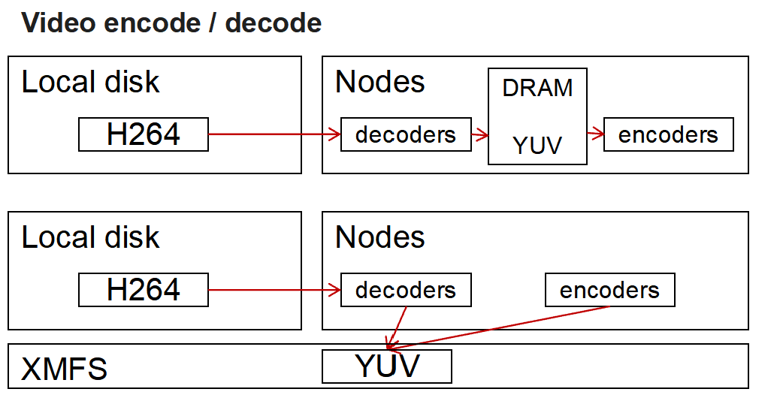
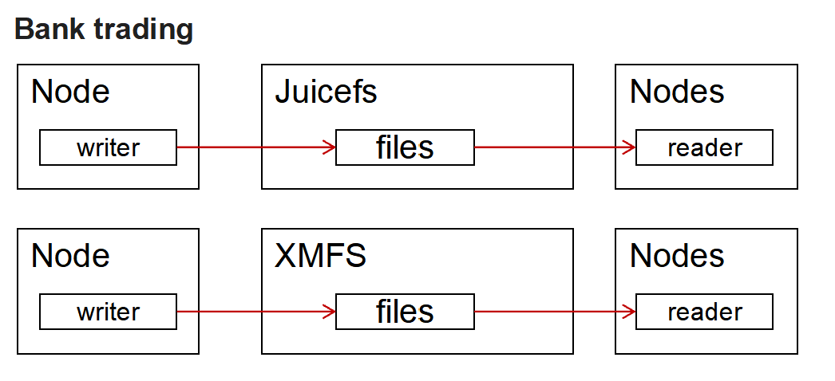
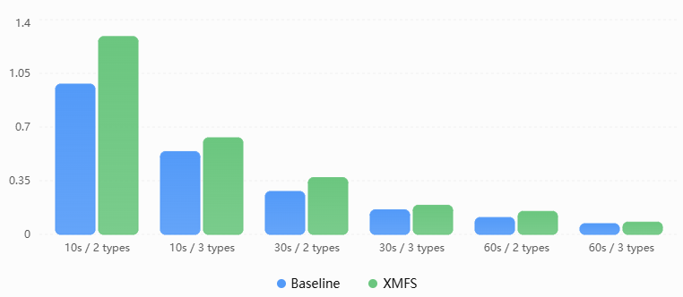
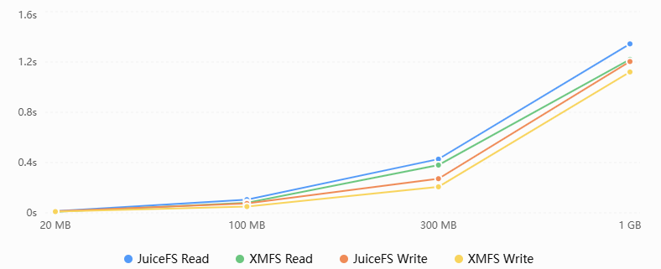
Prototype: shared pipelines
Workers decode slices; other workers encode. Baseline: each node decodes and encodes its own copy. XMFS: one decode, either node encodes the same slice.
Predecessor writes results; another node reads them. Baseline: NAS, or JuiceFS(also uses UB/URMA). Juicefs: writeback; XMFS: server load balance.
Notes:
The second job is a pipeline. Someone produces bytes, someone else consumes them.
In the video encoding and decoding scenario, usually each machine decodes the slice and then encode worker reading it’s from disk or memory. 2 nodes may decode the same slice twice. And needs more workers to decode.
So with XMFS, each nodes has less decode workers and each slice we decode once into the pool; other machine can encode reading it from XMFS. The result is About thirty percent faster.
In the bank trading scenario, each node could writes a result to a file and other nodes need to read it and handlle. The bank was using NAS, or JuiceFS. JuiceFS is adapted to use URMA upon UB now. With XMFS we are 10 to 30 percent faster than JuiceFS on the same jobs.

Slide 12
Future
1. Let XMFS handle the page swap between host and NPU/GPU -- offloading and sharing weights/MoE
2. Reliability: backup, fault tolerance, and failover so a Host or peer failure does not take the service down
Notes:
That is what we have today. And here are two things we want next
Right now a page in XMFS always lives on a host. We already have NPUs and GPUs on the same fabric. we want those pages to be considered. Today there is basically no sharing of weights and MoEs among multi instances — or the sharing is through storage. What we want is offloading and sharing inside the memory pool. Pages move between the host and the NPU or GPU when they need to offload.
And another one is It’s one node owns the namespace and the log slots now. If that node dies today, the filesystem dies with it. That is not acceptable. So the next step is boring on purpose — maybe build a standby Server to keep serving when failover.

Slide 13

UB Community Ecosystem Partnership
Notes:
Finally, I want to put up the partnership of UB community here.
So I will stop there. Happy to take questions.

