Slide 1
The singularity is here for testing: genai advancements on kdevops
Linux Plumbers Conference 2025
Tokyo, Japan
Luis Chamberlain <mcgrof.c@samsung.com>
Daniel Gomez <da.gomez@samsung.com>
Samsung Semiconductor
December 12, 2025

Slide 2
kdevops: intro
What is kdevops:
  Linux distribution agnostic
3f

Slide 3
kdevops: intro
What is kdevops:
  Linux distribution agnostic
    Linux kernel test automation solution
3f

Slide 4
kdevops: intro
What is kdevops:
  Linux distribution agnostic
    Linux kernel test automation solution
    Linux kernel development automation solution
3f

Slide 5
kdevops: intro
What is kdevops:
  Linux distribution agnostic
    Linux kernel test automation solution
    Linux kernel development automation solution
  Kconfig + ansible + CI integration + automatic dashboard
3f

Slide 6
kdevops: intro
What is kdevops:
  Linux distribution agnostic
    Linux kernel test automation solution
    Linux kernel development automation solution
  Kconfig + ansible + CI integration + automatic dashboard
    But docker containers are not suitable for kernel testing !
3f

Slide 7
kdevops: intro
What is kdevops:
  Linux distribution agnostic
    Linux kernel test automation solution
    Linux kernel development automation solution
  Kconfig + ansible + CI integration + automatic dashboard
    guestfs for local virtualization
    terraform or opentofu
      OCI
      AWS
      Azure
      GCE
      OpenStack
3f

Slide 8
kdevops: intro
What is kdevops:
  Linux distribution agnostic
    Linux kernel test automation solution
    Linux kernel development automation solution
  Kconfig + ansible + CI integration + automatic dashboard
    guestfs for local virtualization
    terraform or opentofu
      OCI
      AWS
      Azure
      GCE
      OpenStack
      Neoclouds: Lambda Labs & DataCrunch (Verdi)
3f

Slide 9
kdevops: intro
What is kdevops:
  Linux distribution agnostic
    Linux kernel test automation solution
    Linux kernel development automation solution
  Kconfig + ansible + CI integration + automatic dashboard
    guestfs for local virtualization
    terraform or opentofu
      OCI
      AWS
      Azure
      GCE
      OpenStack
      Neoclouds: Lambda Labs & DataCrunch (Verdi)
    Bare metal
3f

Slide 10
kdevops: intro
What is kdevops:
  Linux distribution agnostic
    Linux kernel test automation solution
    Linux kernel development automation solution
  Kconfig + ansible + CI integration + automatic dashboard
    guestfs for local virtualization
    terraform or opentofu
      OCI
      AWS
      Azure
      GCE
      OpenStack
      Neoclouds: Lambda Labs & DataCrunch (Verdi)
    Bare metal
  All parts of kdevops have been designed with:
    Automation & Scaling philosophy
3f

Slide 11

kdevops: at its core
What is kdevops:
  Kernel automation framework for Linux kernel developers by kernel developers
3f

Slide 12
kdevops: at its core
What is kdevops:
  Kernel automation framework for Linux kernel developers by kernel developers
  Currently supported workflows:
    fstests
    blktests
    selftests
    pynfs
    nfstest
    ltp
    gitr
    sysbench
3f

Slide 13
kdevops: at its core
What is kdevops:
  Kernel automation framework for Linux kernel developers by kernel developers
  Currently supported workflows:
    fstests
    blktests
    selftests
    pynfs
    nfstest
    ltp
    gitr
    sysbench
    mmtests
    Steady State provisioning
    fio-tests
3f

Slide 14
kdevops: at its core
What is kdevops:
  Kernel automation framework for Linux kernel developers by kernel developers
  Currently supported workflows:
    fstests
    blktests
    selftests
    pynfs
    nfstest
    ltp
    gitr
    sysbench
    mmtests
    Steady State provisioning
    fio-tests
    Milvus
    Minio WARP
    vLLM
    vLLM Production Stack
3f

Slide 15
kdevops: at its core
What is kdevops:
  Kernel automation framework for Linux kernel developers by kernel developers
  Currently supported workflows:
    fstests
    blktests
    selftests
    pynfs
    nfstest
    ltp
    gitr
    sysbench
    mmtests
    Steady State provisioning
    fio-tests
    Milvus
    Minio WARP
    vLLM
    vLLM Production Stack
Plugin architecture: custom or even proprietary workflows
knlp: Kernel development style Natural Language Processing R&D
3f

Slide 16
kdevops: at its core
What is kdevops:
  Kernel automation framework for Linux kernel developers by kernel developers
  Currently supported workflows:
    fstests
    blktests
    selftests
    pynfs
    nfstest
    ltp
    gitr
    sysbench
    mmtests
    Steady State provisioning
    fio-tests
    Milvus
    Minio WARP
    vLLM
    vLLM Production Stack
Plugin architecture: custom or even proprietary workflows
knlp: Kernel development style Natural Language Processing R&D
rcloud: leverage terraform for your own servers
Simplified cloud solution for enhancing CI determinism
Implemented in Rust by Generative AI
Alternative to OpenStack, Ubicloud
3f

Slide 17
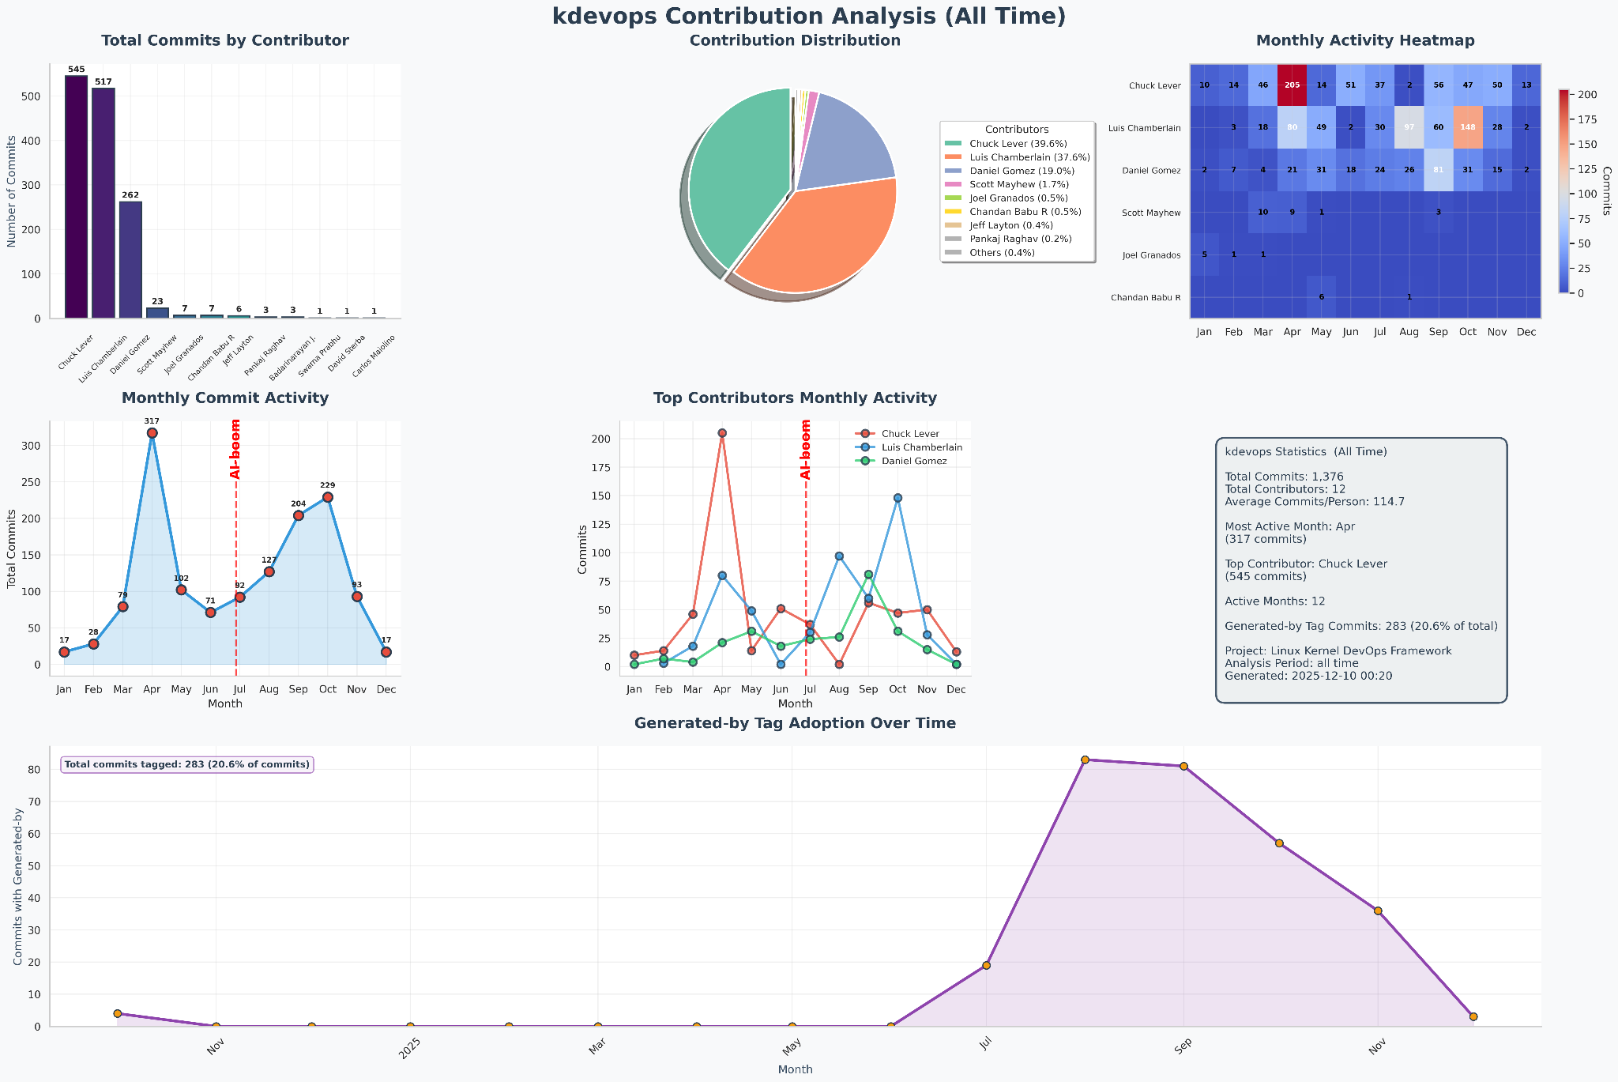
AI impact
is
transformative
Generated-by
3f

Slide 18
AI impact
can be more
transformative
Generated-by
3f

Slide 19
AI impact
can be more
transformative
How?
Generated-by
3f

Slide 20
kdevops: how do we make filesystem tests easier?
3f

Slide 21
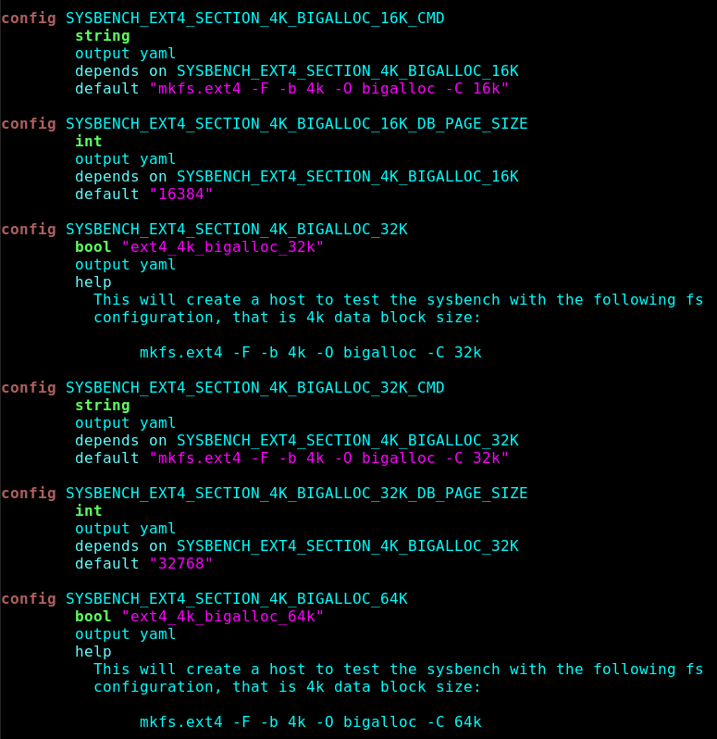
kdevops: how do we make filesystem tests easier?
Kconfig
3f

Slide 22
kdevops: how do we make filesystem tests easier?
Kconfig
LLMs today:
C coding: D-
English: B
Kconfig: A
3f

Slide 23
kdevops: how do we make filesystem tests easier?
Kconfig
LLMs today:
C coding: D-
English: B
Kconfig: A
Forces documentation
Enhances determinism
Enhances automation
Future SAT solver integration
(Boolean Satisfiability)
3f

Slide 24
kdevops: Future SAT solver integration
Future to strive towards
ci-goal:
- filesystem: xfs
- features: [reflink, 4k]
- testsuite: fstests
- tests: generic/750
The less code or Makefiles you have to edit the better
3f

Slide 25
kdevops: dynamic kconfig
Automatically scrapes if releases file is old:
  linux tag
  linux-next tags
  linux-stable tags
3f

Slide 26
kdevops: dynamic kconfig
Automatically scrapes if releases file is old:
  linux tag
  linux-next tags
  linux-stable tags
More scraping:
  make dynconfig
    Supports parsing your PCI tree to enable PCI passthrough
3f

Slide 27
kdevops: dynamic kconfig
Automatically scrapes if releases file is old:
  linux tag
  linux-next tags
  linux-stable tags
More scraping:
  make dynconfig
    Supports parsing your PCI tree to enable PCI passthrough
Theorized:
  Would be nice to dynamically generate cloud configurations
3f

Slide 28
kdevops: dynamic kconfig
Automatically scrapes if releases file is old:
  linux tag
  linux-next tags
  linux-stable tags
More scraping:
  make dynconfig
    Supports parsing your PCI tree to enable PCI passthrough
Theorized:
  Would be nice to dynamically generate cloud configurations
  Generative AI makes this a weekend project
    Lamba Labs
3f

Slide 29
kdevops: dynamic kconfig
Automatically scrapes if releases file is old:
  linux tag
  linux-next tags
  linux-stable tags
More scraping:
  make dynconfig
    Supports parsing your PCI tree to enable PCI passthrough
Theorized:
  Would be nice to dynamically generate cloud configurations
  Generative AI makes this a weekend project
    Lamba Labs
    AWS
3f

Slide 30
kdevops: adaptations are easier for AI
Philosophy:
  Write out code once
3f

Slide 31
kdevops: adaptations are easier for AI
Philosophy:
  Write out code once
  Automate afterwards
3f

Slide 32
kdevops: adaptations are easier for AI
Philosophy:
  Write out code once
  Automate afterwards
Case study:
  Sysbench TPS variability evaluation for MySQL & PostgreSQL
3f

Slide 33
kdevops: adaptations are easier for AI
Philosophy:
  Write out code once
  Automate afterwards
Case study:
  Sysbench TPS variability evaluation for MySQL & PostgreSQL
  https://github.com/mcgrof/plot-sysbench
    Here are the scripts, port this to kdevops: AI grade in 2024: D-
3f

Slide 34
kdevops: adaptations are easier for AI
Philosophy:
  Write out code once
  Automate afterwards
Case study:
  Sysbench TPS variability evaluation for MySQL & PostgreSQL
  https://github.com/mcgrof/plot-sysbench
    Here are the scripts, port this to kdevops: AI grade in 2024: D-
    Plots: A+
3f

Slide 35
kdevops: adaptations are easier for AI
Philosophy:
  Write out code once
  Automate afterwards
Case study:
  Sysbench TPS variability evaluation for MySQL & PostgreSQL
  https://github.com/mcgrof/plot-sysbench
    Here are the scripts, port this to kdevops: AI grade in 2024: D-
    Plots: A+
    This is only getting better
    2024 SOTA: sysbench
    2025 SOTA: new world
2025: Port Milvus scripts
  AI Grade in 2025: B-
3f

Slide 36
Empirical evaluation of AI prompts and grading
kdevops PROMPTS.md
3f

Slide 37
kdevops: Linux software 3.0 enabler
Andrej Karpathy: AI researcher, founding member OpenAI, ex-Tesla AI lead
3f

Slide 38
kdevops: Linux software 3.0 enabler
Andrej Karpathy: AI researcher, founding member OpenAI, ex-Tesla AI lead
  Software 1.0: manually written code
3f

Slide 39
kdevops: Linux software 3.0 enabler
Andrej Karpathy: AI researcher, founding member OpenAI, ex-Tesla AI lead
  Software 1.0: manually written code
  2017 - Software 2.0: trained neural networks to write code
3f

Slide 40
kdevops: Linux software 3.0 enabler
Andrej Karpathy: AI researcher, founding member OpenAI, ex-Tesla AI lead
  Software 1.0: manually written code
  2017 - Software 2.0: trained neural networks to write code
  2023 - Software 3.0: programming carefully with English
3f

Slide 41
kdevops: Linux software 3.0 enabler
Andrej Karpathy: AI researcher, founding member OpenAI, ex-Tesla AI lead
  Software 1.0: manually written code
  2017 - Software 2.0: trained neural networks to write code
  2023 - Software 3.0: programming carefully with English
  2025 - Vibe coding: loosely prompting and hope it works
3f

Slide 42

kdevops: Linux software 3.0 enabler
Andrej Karpathy: AI researcher, founding member OpenAI, ex-Tesla AI lead
  Software 1.0: manually written code
  2017 - Software 2.0: trained neural networks to write code
  2023 - Software 3.0: programming carefully with English
  2025 - Vibe coding: loosely prompting and hope it works
3f

Slide 43
kdevops: Linux software 3.0 enabler
Andrej Karpathy: AI researcher, founding member OpenAI, ex-Tesla AI lead
  Software 1.0: manually written code
  2017 - Software 2.0: trained neural networks to write code
  2023 - Software 3.0: programming carefully with English
  2025 - Vibe coding: loosely prompting and hope it works
Constrain the grammar
Make automation a fundamental part of the architecture
3f

Slide 44
kdevops: singularity for testing is here
What is the singularity?
3f

Slide 45
kdevops: singularity for testing is here
What is the singularity?
Borrowed from physics: you can’t see beyond the event horizon
3f

Slide 46
kdevops: singularity for testing is here
What is the singularity?
Borrowed from physics: you can’t see beyond the event horizon
I can’t no longer predict clearly what we cannot do on kdevops
3f

Slide 47
kdevops: singularity for testing is here
What is the singularity?
Borrowed from physics: you can’t see beyond the event horizon
I can’t no longer predict clearly what we cannot do on kdevops
Time estimates for project scoping is way off
3f

Slide 48
kdevops: singularity for testing is here
What is the singularity?
Borrowed from physics: you can’t see beyond the event horizon
I can’t no longer predict clearly what we cannot do on kdevops
Time estimates for project scoping is way off
In writing these slides I couldn’t keep track of all new features added
3f

Slide 49
kdevops: singularity for testing is here
What is the singularity?
Borrowed from physics: you can’t see beyond the event horizon
I can’t no longer predict clearly what we cannot do on kdevops
Time estimates for project scoping is way off
In writing these slides I couldn’t keep track of all new features added
I’m having a hard time prioritizing innovations
3f

Slide 50
kdevops: singularity for testing is here
What is the singularity?
Borrowed from physics: you can’t see beyond the event horizon
I can’t no longer predict clearly what we cannot do on kdevops
Time estimates for project scoping is way off
In writing these slides I couldn’t keep track of all new features added
I’m having a hard time prioritizing innovations
It’s not just me
3f

Slide 51
kdevops: talk is cheap
How has this been used for something productive on Linux?
3f

Slide 52

Use cases
v6.12: block size > page size for filesystems: LBS
v6.15: block size > page size on the block layer
https://semiconductor.samsung.com/news-events/tech-blog/dividing-and-conquering-linux-high-capacity-ssd-support-with-lbs-ep1/
TPS variability: large atomics make sense for databases
vLLM production stack bringup is now easy
Parallel Writeback: 212% performance improvement
3f

Slide 53

kdevops-results-archive
We need a home to archive as much data as is possible for results
We need infinite storage
3f

Slide 54
kdevops-results-archive
We need a home to archive as much data as is possible for results
We need infinite storage
  git LFS
  rotate git trees by epoch
3f

Slide 55
kdevops latest dog trick
CI is a pain point
Generalizing it would be amazing
Yes you can partial vibe-code but also painful to test
The most nasty party of automation
3f

Slide 56
kdevops latest dog trick
CI is a pain point
Generalizing it would be amazing
Yes you can partial vibe-code but also painful to test
The most nasty party of automation
Goal: avoid developers having to touch it
3f

Slide 57
kdevops latest dog trick
CI is a pain point
Generalizing it would be amazing
Yes you can partial vibe-code but also painful to test
The most nasty party of automation
Goal: avoid developers having to touch it
Generalizing CI is possible and done: Kudos to Daniel Gomez
3f

Slide 58
Turning kdevops into CI accelerator
kdevops supports +100 profiles among different workflows
  xfs, btrfs, ext4, tmpfs, nfs, blktests, modules, kmod, xarray, maple, firmware…

Slide 59
Turning kdevops into CI accelerator
kdevops supports +100 profiles among different workflows
  xfs, btrfs, ext4, tmpfs, nfs, blktests, modules, kmod, xarray, maple, firmware…
blktests_block
blktests_loop
blktests_meta
blktests_nbd
blktests_nvme
blktests_nvmemp
blktests_scsi
blktests_srp
blktests_zbd

Slide 60
Turning kdevops into CI accelerator
kdevops supports +100 profiles among different workflows
  xfs, btrfs, ext4, tmpfs, nfs, blktests, modules, kmod, xarray, maple, firmware…
btrfs_fspace
btrfs_fspace_dsync
btrfs_fspace_lzo
btrfs_fspace_zlib
btrfs_fspace_zstd
btrfs_holes
btrfs_holes_lzo
btrfs_holes_zlib
btrfs_holes_zstd
btrfs_nohofspace
btrfs_nohofspace_lzo
btrfs_nohofspace_zlib
btrfs_nohofspace_zstd
btrfs_noholes
btrfs_noholes_lzo
btrfs_noholes_zlib
btrfs_noholes_zstd
btrfs_simple
btrfs_simple_zns

Slide 61
Turning kdevops into CI accelerator
kdevops supports +100 profiles among different workflows
  xfs, btrfs, ext4, tmpfs, nfs, blktests, modules, kmod, xarray, maple, firmware…
ext4_1k
ext4_2k
ext4_4k
ext4_advanced_features
ext4_bigalloc1024k_4k
ext4_bigalloc16k_4k
ext4_bigalloc2048k_4k
ext4_bigalloc32k_4k
ext4_bigalloc64k_4k
ext4_bigalloc8k_4k
ext4_defaults

Slide 62
Turning kdevops into CI accelerator
kdevops supports +100 profiles among different workflows
  xfs, btrfs, ext4, tmpfs, nfs, blktests, modules, kmod, xarray, maple, firmware…
nfs-fstests-pnfs
nfs-fstests-v41
nfs-fstests-v42
nfs-gitr-pnfs
nfs-gitr-v42

Slide 63
Turning kdevops into CI accelerator
kdevops supports +100 profiles among different workflows
  xfs, btrfs, ext4, tmpfs, nfs, blktests, modules, kmod, xarray, maple, firmware…
selftests-firmware
selftests-kmod
selftests-maple
selftests-module
selftests-vma
selftests-xarray

Slide 64
Turning kdevops into CI accelerator
kdevops supports +100 profiles among different workflows
  xfs, btrfs, ext4, tmpfs, nfs, blktests, modules, kmod, xarray, maple, firmware…
tmpfs_default
tmpfs_huge_advise
tmpfs_huge_always
tmpfs_huge_within_size
tmpfs_noswap_huge_advise
tmpfs_noswap_huge_always
tmpfs_noswap_huge_never
tmpfs_noswap_huge_within_size

Slide 65
Turning kdevops into CI accelerator
kdevops supports +100 profiles among different workflows
  xfs, btrfs, ext4, tmpfs, nfs, blktests, modules, kmod, xarray, maple, firmware…
xfs_crc
xfs_crc_logdev
xfs_crc_logdev_rtdev
xfs_crc_rtdev
xfs_crc_rtdev_extsize_28k
xfs_crc_rtdev_extsize_64k
xfs_nocrc
xfs_nocrc_16k_4ks
xfs_nocrc_1k
xfs_nocrc_2k
xfs_nocrc_32_4ks
xfs_nocrc_4k
xfs_nocrc_512
xfs_nocrc_64_4ks
xfs_nocrc_8k_4ks
xfs_reflink_1024
xfs_reflink_16k_4ks
xfs_reflink_2k
xfs_reflink_32k_4ks
xfs_reflink_4k
xfs_reflink_4k_8ks
xfs_reflink_64k_4ks
xfs_reflink_8k_4ks
xfs_reflink_dir_bsize_8k
xfs_reflink_logdev
xfs_reflink_normapbt
xfs_reflink_nrext64
xfs_reflink_stripe_len

Slide 66
Turning kdevops into CI accelerator
kdevops supports +100 profiles among different workflows
  xfs, btrfs, ext4, tmpfs, nfs, blktests, modules, kmod, xarray, maple, firmware…
sysbench_postgresql_ext4_4k
sysbench_postgresql_ext4_4k_bigalloc_16k
sysbench_postgresql_ext4_4k_bigalloc_32k
sysbench_postgresql_ext4_4k_bigalloc_64k
sysbench_postgresql_xfs_reflink_16k
sysbench_postgresql_xfs_reflink_32k
sysbench_postgresql_xfs_reflink_4k
sysbench_postgresql_xfs_reflink_64k
sysbench_postgresql_xfs_reflink_8k

Slide 67
Turning kdevops into CI accelerator
kdevops supports +100 profiles among different workflows
  xfs, btrfs, ext4, tmpfs, nfs, blktests, modules, kmod, xarray, maple, firmware…
sysbench_mysql_ext4_4k
sysbench_mysql_ext4_4k_bigalloc_16k
sysbench_mysql_ext4_4k_bigalloc_32k
sysbench_mysql_ext4_4k_bigalloc_64k
sysbench_mysql_xfs_reflink_16k
sysbench_mysql_xfs_reflink_32k
sysbench_mysql_xfs_reflink_4k
sysbench_mysql_xfs_reflink_64k
sysbench_mysql_xfs_reflink_8k

Slide 68
Turning kdevops into CI accelerator
kdevops supports +100 profiles among different workflows
  xfs, btrfs, ext4, tmpfs, nfs, blktests, modules, kmod, xarray, maple, firmware…
Host
xfs
crc
logdev
xfs
crc
rtdev
blktests
nvme
tmpfs
huge
noswap
4GB/8c
4GB/8c
4GB/8c
4GB/8c

Slide 69
Turning kdevops into CI accelerator
kdevops supports +100 profiles among different workflows
  xfs, btrfs, ext4, tmpfs, nfs, blktests, modules, kmod, xarray, maple, firmware…
How do we automate testing in the background? → CI
  GitHub Actions (Reusable)
    Easy
    Extremely painful

Slide 70
Turning kdevops into CI accelerator
kdevops supports +100 profiles among different workflows
  xfs, btrfs, ext4, tmpfs, nfs, blktests, modules, kmod, xarray, maple, firmware…
How do we automate testing in the background? → CI
  kdevops-ci → Test and validate kdevops framework
Host
xfs
crc
logdev
xfs
crc
rtdev
blktests
nvme
tmpfs
huge
noswap
Capacity
32 runners
2GB/2c
2GB/2c
2GB/2c
2GB/2c
Runner
Runner
Runner
Runner

Slide 71
Turning kdevops into CI accelerator
kdevops supports +100 profiles among different workflows
  xfs, btrfs, ext4, tmpfs, nfs, blktests, modules, kmod, xarray, maple, firmware…
How do we automate testing in the background? → CI
  kdevops-ci
  linux-ci → Test and validate a specific profile on a specific Linux version
Host
xfs
crc
logdev
xfs
crc
rtdev
blktests
nvme
tmpfs
huge
noswap
Capacity
16 runners
4GB/8c
4GB/8c
4GB/8c
4GB/8c
Runner
Runner
Runner
Runner

Slide 72
Turning kdevops into CI accelerator
kdevops supports +100 profiles among different workflows
  xfs, btrfs, ext4, tmpfs, nfs, blktests, modules, kmod, xarray, maple, firmware…
How do we automate testing in the background? → CI
  kdevops-ci, linux-ci
  *kpd → Test and validate a specific profile on a specific Linux version
  with a patch posted on lore
    Uses kernel-patch-daemon to trigger a specific linux-ci
Host
Host
kpd
module
kmod
Capacity
32 runners
4GB/8c
4GB/8c
Runner
Runner

Slide 73
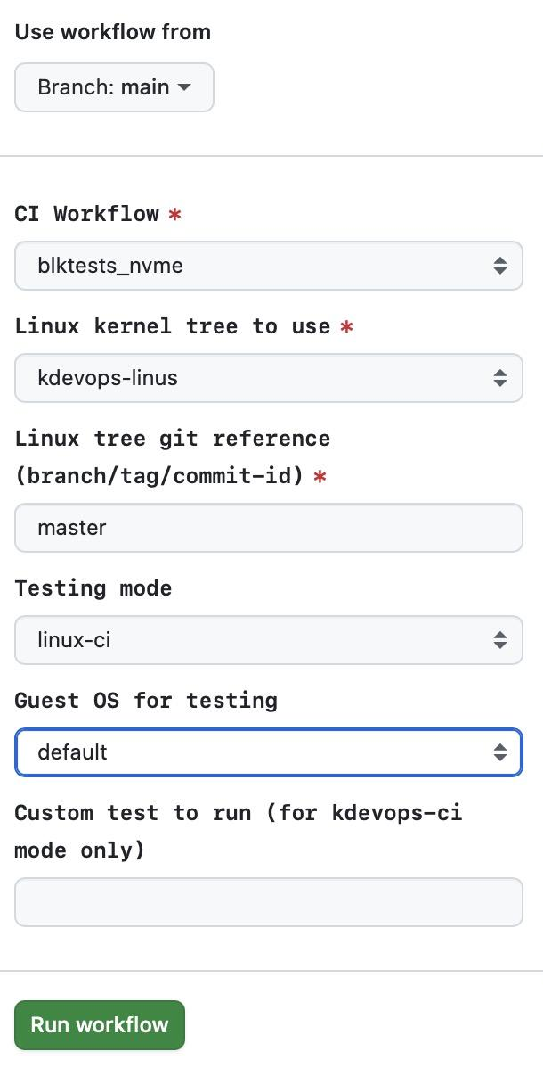
Turning kdevops into CI accelerator
kdevops supports +100 profiles among different workflows
  xfs, btrfs, ext4, tmpfs, nfs, blktests, modules, kmod, xarray, maple, firmware…
How do we automate testing in the background? → CI
  kdevops-ci, linux-ci, *kpd
  linux-kdevops → Test any branch with any profile using linux-ci

Slide 74
Turning kdevops into CI accelerator
kdevops-ci
  Verifies every MR
  Can be run on demand with ci-testing/** ref namespace
linux-ci
  Daily run of profiles against latest linux-next tag
  Weekly run of profiles against latest Linus release or release candidate

Slide 75
Turning kdevops into CI accelerator
How do we scale?
linux-ci
  Daily run of profiles against latest linux-next tag
  Weekly run of profiles against latest Linus release or release candidate
Host
xfs
crc
logdev
xfs
crc
rtdev
blktests
nvme
tmpfs
huge
noswap
Capacity
16 runners
4GB/8c
4GB/8c
4GB/8c
4GB/8c
Runner
Runner
Runner
Runner

Slide 76
Turning kdevops into CI accelerator
How do we scale?
linux-ci
  Daily run of profiles against latest linux-next tag
  Weekly run of profiles against latest Linus release or release candidate
Host
Host
xfs
crc
logdev
xfs
crc
rtdev
blktests
nvme
tmpfs
huge
noswap
Capacity
16 runners
xfs
crc
logdev
xfs
crc
rtdev
blktests
nvme
tmpfs
huge
noswap
Capacity
32 runners
4GB/8c
4GB/8c
4GB/8c
4GB/8c
4GB/8c
4GB/8c
4GB/8c
4GB/8c
Runner
Runner
Runner
Runner
Runner
Runner
Runner
Runner
Host
Host
xfs
crc
logdev
xfs
crc
rtdev
blktests
nvme
tmpfs
huge
noswap
Capacity
8 runners
xfs
crc
logdev
xfs
crc
rtdev
blktests
nvme
tmpfs
huge
noswap
Capacity
4 runners
4GB/8c
4GB/8c
4GB/8c
4GB/8c
4GB/8c
4GB/8c
4GB/8c
4GB/8c
Runner
Runner
Runner
Runner
Runner
Runner
Runner
Runner

Slide 77
Turning kdevops into CI accelerator
How do we scale?
linux-ci
  Daily run of profiles against latest linux-next tag
  Weekly run of profiles against latest Linus release or release candidate
kdevops normal workflow
  Setup configuration (Kconfig)
  Idempotent host setup
  Idempotent bringup (VM creation and basic initialization)
  Idempotent workflow installation (tooling and testing framework installation)
  Idempotent workflow setup (testing framework configuration)
  Linux build
  Linux install

Slide 78
Turning kdevops into CI accelerator
How do we scale?
kdevops normal workflow
  Linux build (uses host nproc)
  Every runner competes for the same resources
Host
Host
xfs
crc
logdev
xfs
crc
rtdev
blktests
nvme
tmpfs
huge
noswap
Capacity
16 runners
xfs
crc
logdev
xfs
crc
rtdev
blktests
nvme
tmpfs
huge
noswap
Capacity
32 runners
4GB/8c
4GB/8c
4GB/8c
4GB/8c
4GB/8c
4GB/8c
4GB/8c
4GB/8c
Runner
Runner
Runner
Runner
Runner
Runner
Runner
Runner
Host
Host
xfs
crc
logdev
xfs
crc
rtdev
blktests
nvme
tmpfs
huge
noswap
Capacity
8 runners
xfs
crc
logdev
xfs
crc
rtdev
blktests
nvme
tmpfs
huge
noswap
Capacity
4 runners
4GB/8c
4GB/8c
4GB/8c
4GB/8c
4GB/8c
4GB/8c
4GB/8c
4GB/8c
Runner
Runner
Runner
Runner
Runner
Runner
Runner
Runner

Slide 79
Turning kdevops into CI accelerator
How do we scale?
kdevops normal workflow
  Linux build (uses host nproc)
  Every runner competes for the same resources
Host
Host
xfs
crc
logdev
Build
Linux
blktests
nvme
tmpfs
huge
noswap
Capacity
16 runners
xfs
crc
logdev
Build
Linux
blktests
nvme
tmpfs
huge
noswap
Capacity
32 runners
4GB/8c
4GB/8c
4GB/8c
4GB/8c
4GB/8c
4GB/8c
4GB/8c
4GB/8c
Host
Host
xfs
crc
logdev
Build
Linux
blktests
nvme
tmpfs
huge
noswap
Capacity
8 runners
xfs
crc
logdev
Build
Linux
blktests
nvme
tmpfs
huge
noswap
Capacity
4 runners
4GB/8c
4GB/8c
4GB/8c
4GB/8c
4GB/8c
4GB/8c
4GB/8c
4GB/8c

Slide 80
Turning kdevops into CI accelerator
How do we scale?
kdevops normal workflow
  Linux builder runner (uses host nproc)
Host
Host
xfs
crc
logdev
xfs
crc
rtdev
blktests
nvme
tmpfs
huge
noswap
Capacity
16 runners
xfs
crc
logdev
xfs
crc
rtdev
blktests
nvme
Build
Linux
Capacity
32 runners
4GB/8c
4GB/8c
4GB/8c
4GB/8c
4GB/8c
4GB/8c
4GB/8c
Runner
Runner
Runner
Runner
Runner
Runner
Runner
Runner
Host
Host
xfs
crc
logdev
xfs
crc
rtdev
blktests
nvme
tmpfs
huge
noswap
Capacity
8 runners
xfs
crc
logdev
xfs
crc
rtdev
blktests
nvme
tmpfs
huge
noswap
Capacity
4 runners
4GB/8c
4GB/8c
4GB/8c
4GB/8c
4GB/8c
4GB/8c
4GB/8c
4GB/8c
Runner
Runner
Runner
Runner
Runner
Runner
Runner
Runner

Slide 81
Turning kdevops into CI accelerator
How do we scale?
kdevops normal workflow
  Linux builder runner (uses host nproc)
  Problem: No support for heterogeneous runners, scheduling preference
Host
Host
xfs
crc
logdev
xfs
crc
rtdev
blktests
nvme
tmpfs
huge
noswap
Capacity
16 runners
xfs
crc
logdev
xfs
crc
rtdev
blktests
nvme
Build
Linux
Capacity
32 runners
4GB/8c
4GB/8c
4GB/8c
4GB/8c
4GB/8c
4GB/8c
4GB/8c
Runner
Runner
Runner
Runner
Runner
Runner
Runner
Runner
Host
Host
xfs
crc
logdev
xfs
crc
rtdev
blktests
nvme
tmpfs
huge
noswap
Capacity
8 runners
xfs
crc
logdev
xfs
crc
rtdev
blktests
nvme
tmpfs
huge
noswap
Capacity
4 runners
4GB/8c
4GB/8c
4GB/8c
4GB/8c
4GB/8c
4GB/8c
4GB/8c
4GB/8c
Runner
Runner
Runner
Runner
Runner
Runner
Runner
Runner

Slide 82
Turning kdevops into CI accelerator
How do we scale?
linux-ci
  Daily run of profiles against latest linux-next tag
  Weekly run of profiles against latest Linus release or release candidate
blktests
Host
xfs
crc
logdev
xfs
crc
rtdev
blktests
nvme
tmpfs
huge
noswap
Capacity
16 runners
4GB/8c
4GB/8c
4GB/8c
4GB/8c
Runner
Runner
Runner
Runner

Slide 83
Turning kdevops into CI accelerator
How do we scale?
linux-ci
  Daily run of profiles against latest linux-next tag
  Weekly run of profiles against latest Linus release or release candidate
blktests
modules
Host
xfs
crc
logdev
xfs
crc
rtdev
blktests
nvme
tmpfs
huge
noswap
Capacity
16 runners
4GB/8c
4GB/8c
4GB/8c
4GB/8c
Runner
Runner
Runner
Runner

Slide 84
Turning kdevops into CI accelerator
How do we scale?
linux-ci
  Daily run of profiles against latest linux-next tag
  Weekly run of profiles against latest Linus release or release candidate
blktests
modules
Report to mailing lists?
Host
xfs
crc
logdev
xfs
crc
rtdev
blktests
nvme
tmpfs
huge
noswap
Capacity
16 runners
4GB/8c
4GB/8c
4GB/8c
4GB/8c
Runner
Runner
Runner
Runner

