Slide 1
Automating Linux Kernel Documentation for Safety-Critical Compliance through Large-Language Models
Presented by Justin Stanley & Grant Stensland
LPC 2025

Slide 2
Who We Are
VES LLC | A Waséyabek Company
Core Competencies
Established in 2014
100% Tribally-owned holding company
Team located across United States
Main headquarters is located in Maryland with an annex office in Michigan
Personnel located on all coasts from the DC Metro to Seattle
80+ Full-time employees and growing rapidly
Custom infrastructure development for embedded environments
Embedded systems integration (OSs, BSPs, Application porting)
Edge prototyping of emerging technologies
Deployable software products with secure container orchestration
Security and compliance via DevSecOps and Zero Trust
ISO 9001-2015 Certified

Slide 3

Acknowledgements
Community Thanks
Safe Systems with Linux Microconference
Steven Rostedt for kernel documentation validity feedback
The ELISA team for the insightful discussions and effort that helped spark this investigation
Tomorrow starting at 10:00 AM in Hall B4
Aspects of Dependable Linux Systems
NVIDIA Approach for Achieving ASIL B Qualified Linux
Applying Program Verification to Linux Kernel Code
Defining and maintaining requirements in the Linux Kernel
KUnit Testing Insufficiencies
Exploring possibilities for integrating StrictDoc with ELISA's requirements template approach for the Linux kernel
BASIL: Open-Source Traceability for Safety-Critical Systems
Tooling and Sharing Traceability Discussion

Slide 4






Agenda
Motivation
2) Case Study
3) Tech Overview
4) Results
5) Next Steps
6) Q&A

Slide 5
Motivation

Slide 6

Motivation: The Compliance Challenge
Despite its technical maturity and reliability. Linux is unusable in safety-critical applications in the domains of aerospace, automation, and defense.
The key barrier is regulatory compliance, not performance. Standards such as ASIL or DO-178C require rigorous standardized documentation.
This documentation emphasizes accuracy, reproducibility, and traceability.
Producing this documentation manually is slow and costly, often taking years of effort. Especially when not done up front.
The Linux kernel, though technically robust and widely used, lacks certification-ready documentation, limiting its use in regulated domains.
There is a growing gap between open-source innovation and the rigor demanded by certification authorities.

Slide 7
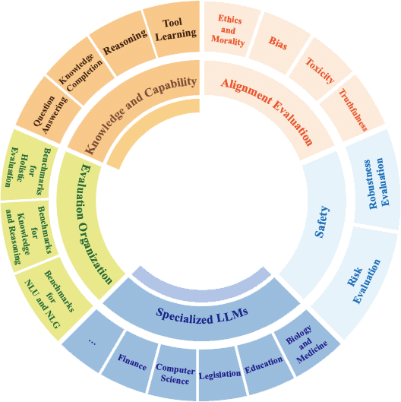

Motivation: Leveraging LLMs
Large Language Models (LLMs) can summarize complex functions, explain algorithms, and highlight assumptions.
Models can potentially detect undocumented edge cases or conditions needing clarification
LLMs can help "translate" expert-level kernel code into safety-auditor-friendly language
LLMs cannot guarantee correctness, formal verification, or certification compliance.
Outputs require validation by human experts. LLMs can assist, but do not replace safety engineers.
The value lies in accelerating documentation, not in automating the entire certification process.

Slide 8
Case Study

Slide 9
Case Study: Applying LLMs to ftrace
Case Study
Specifications
Explore whether locally deployed LLMs can automate documentation generation that aligns with safety-critical standards.
Apply this approach to the Linux kernel's ftrace utility.
Evaluation metrics:
Validity and standards alignment of generated documentation
Computational performance in relation to each LLM
Reproducibility of outputs
Workstation specs:
Ubuntu 22.04
Intel i7 14700k CPU
Nvidia RTX 4000 Ada GPU
Families of LLMs evaluated:
Meta Llama 3.2
StarCoder2
Mistral Devstral

Slide 10

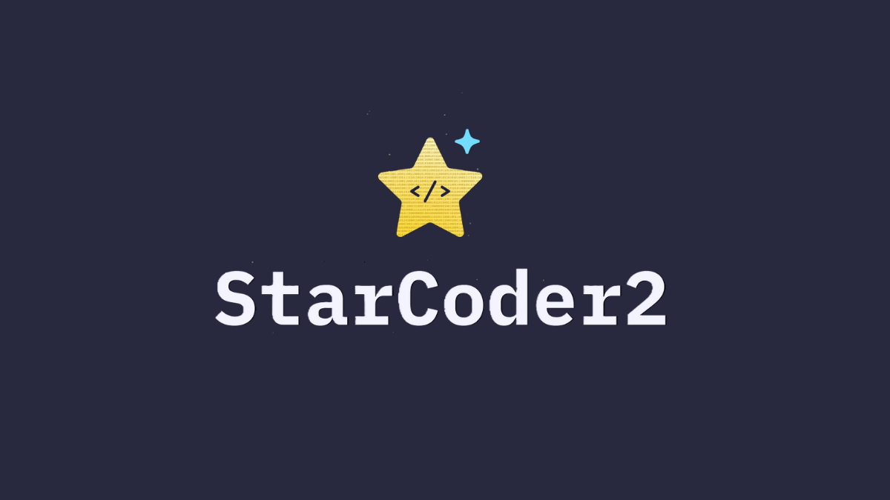

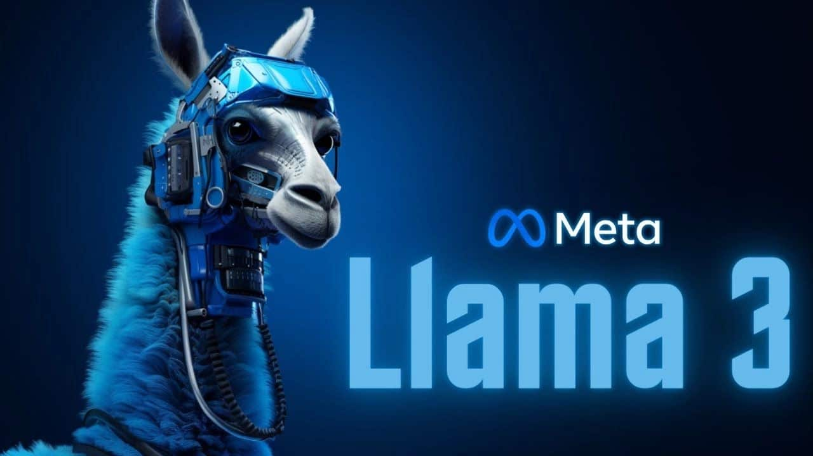
Case Study: Model Downselect
Compatibility with Ollama
Compute Efficiency Metrics
Prompt Used
All LLMs open source and compatible with Ollama front end
All models relatively mature and stable at the time of the study
Balanced spectrum of model size and capabilities
Model size (GB)
Parameter count (B)
Speed (Tokens / Second)
Maximum Context Window (K tokens)
"For Function's expectations: provide several lines of explanation for how every combination of arguments will affect the output start each explanation with a " -" MAKE SURE TO ALWAYS PRODUCE A C BLOCK COMMENT, only produce one block comment"

Slide 11
Technical Overview

Slide 12



Requirements
Conciseness
Reproducibility
Model Robustness
Easily reviewable for practical integration
Concise for effective requirement tracing
Minimize ambiguity to support audits
Reduced noise in outputs
More reliable tests and prompt tuning
Stable results across minor prompt changes and configurations
Easily deploy LLMs to target hardware
Remote inference for deployment flexibility
Modular deployment to support model substitution for evaluation

Slide 13



Existing Software
.
.
Ollama
Tree-sitter
Open-source LLM backend
Remote inference via REST API
Public model registry, easily swappable
Supports multiple models for comparison and benchmarking
Open-source incremental language parser supporting multiple languages
Provides reliable syntax trees for analyzing and reconstructing code
Enables consistent validation of LLM-generated output

Slide 14
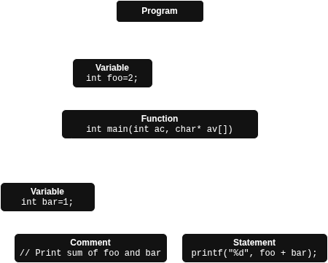
Tree-sitter and ASTs
int foo=2;
int main(int ac, char* av[]) {
int bar=1;
// Print sum of foo and bar
printf("%d", foo + bar);
}
Tree-sitter provides an open-source, language agnostic parser
We focus on parsing C code to target the Linux kernel
Parsing other languages requires minimal changes, just loading new parser modules
Parser converts source code text into AST structures (Abstract Syntax Tree)
ASTs describe the program's semantic meaning
Used similarly by compilers for code generation
We use them to extract functions for documentation, and later for building and verifying newly generated source files

Slide 15
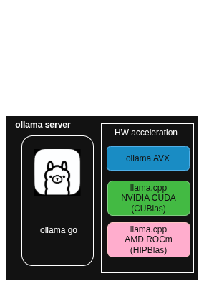
Ollama
Robust LLM backend, supporting wide range of target hardware for both local and on-prem deployment
GPU-agnostic hardware acceleration using CUDA, ROCm, AVX, and other backends
Remote inference via REST API for simple and easy integration
Straightforward scaling with built-in support for load balancing
Mature client libraries (Python, JavaScript, Go, etc.) enabling seamless integration
Public model registry with easily interchangeable open-weight models

Slide 16
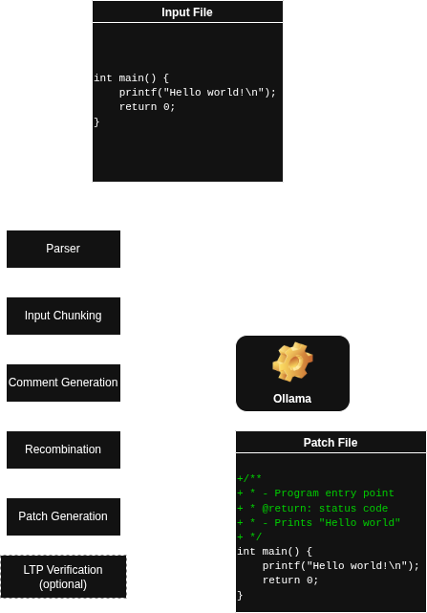

Pipeline Overview
Highly parallelizable (per input file)
Swappable, load-balanced LLM backend
Implicit (semantic) and explicit (LTP) verification
Implicit verification before patch generation
Explicit verification by running tests on newly built binaries
Linux Test Project
Git-ready patch files produced for each input source file

Slide 17
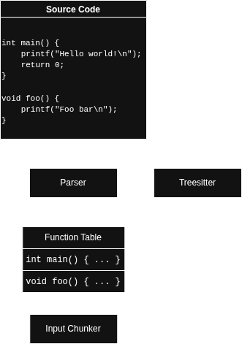
Function Parsing
Initial stage of the input pipeline, responsible for extracting structured information from source code
Source code is passed to Tree-sitter which collects body and metadata for each function in top-level scope
Extracted data includes:
Function body (source code)
Function signature (params, return value)
Function location (file, line number)
Parsed function data is stored and passed to the next pipeline stage, Input Chunking

Slide 18
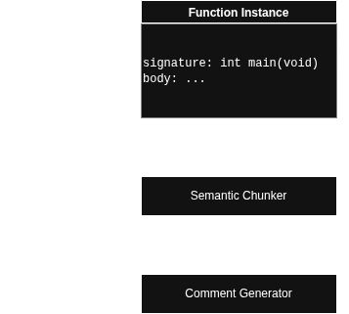
Input Chunking
After collecting functions from the original source, we prepare to submit them to the LLM
However, LLMs have input size limitations
If functions are too large, we split the body into chunks
How to pick chunk boundaries?
Naïve chunking: align chunks exactly with LLM token limit
Source code tokens might land on chunk boundary and "confuse" LLM
Smart chunking: use Tree-sitter to pick a chunk boundary between source code tokens
Code is broken into ingestible, independent chunks

Slide 19
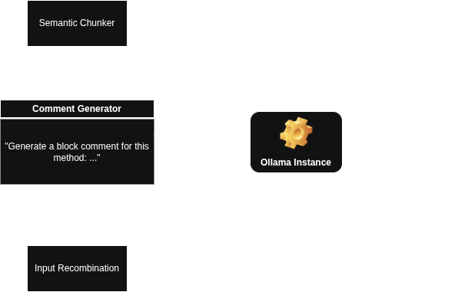
Comment Generation
Chunks of function bodies are sent to the LLM after input chunking stage
Uses a fixed prompt with documentation instructions combined with source code
Request are made to the Ollama instance via the REST API for inference
Documentation received is saved along with function metadata (file, location, body)
Newly documented functions are then forwarded to the next stage: Input Recombination

Slide 20
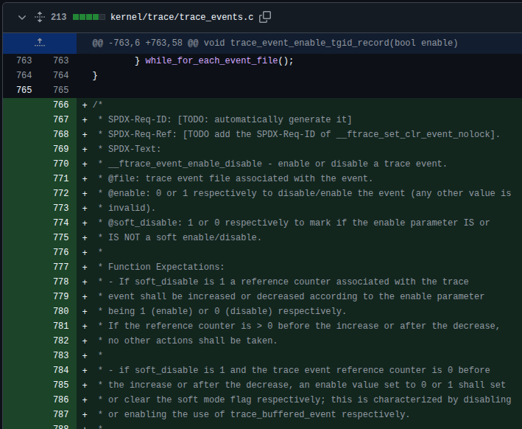
Prompt Selection
We use a fixed prompt to instruct LLM to generate documentation, but how do we pick a strong prompt?
Follow established formatting from existing ELISA efforts
Emphasis on producing traceable requirements
Example patches for ftrace source code
SPDX tags require unique IDs, referencing – LLMs shouldn't generate these
Future work: extending pipeline to directly add SPDX tags
Iteratively refine prompt, identifying one that produces consistently formatted output
GitHub: elisa-tech/linux
Generate a C-style block comment for the following function.
Limit overall width to 80 columns.
Start the comment with "* <method> - <description of the method>".
Follow with "@<param>: - <description of the param>" for each parameter.
Follow with "* Function Expectations:".
Follow with "- <behavior expectation>" for each major function behavior.
Follow with a description of the return value.
--
int main(int argc, char* argv[]) { … }
System prompt

Slide 21
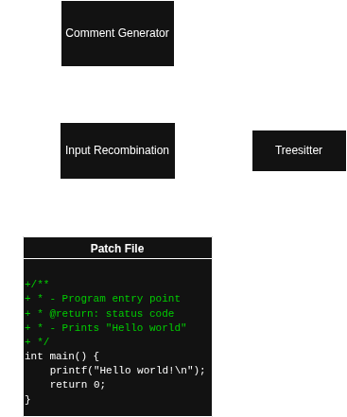
Input Recombination
The comment generator produces a set of documented functions, but we still need to combine them into a complete, documented source file
Need to keep the rest of the code unchanged! Behavior should never differ
We build the output and verify it using Tree-sitter
Function metadata includes location, which we use to correctly insert documentation into the new source file
After building a complete output file, we parse it into a new AST
Now, we have an AST for the original source alongside an AST for the new source
We compare the ASTs, verifying comment nodes are the only difference
Output file is guaranteed to not change behavior

Slide 22
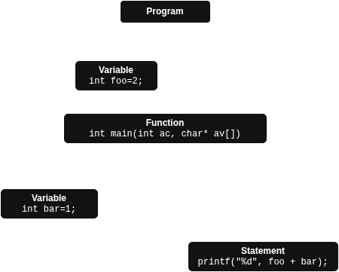
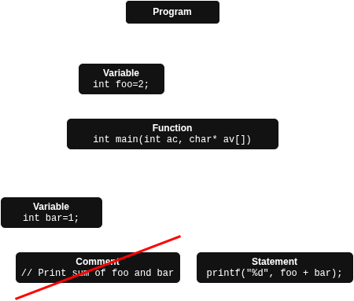
AST Verification
Original undocumented source
New documented source

Slide 23
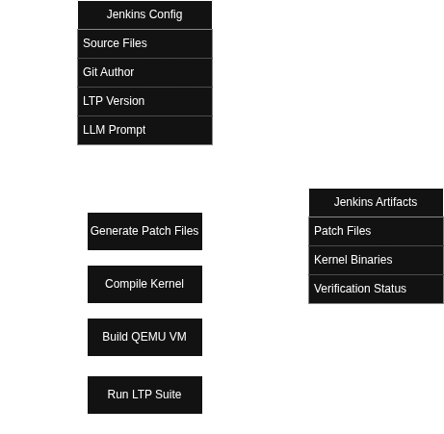

Jenkins & LTP Verification
We deployed the pipeline into Jenkins CI to support development and improve validation
Rapid iteration and testing
More verification by running tests on newly built kernels
LTP (Linux Test Project) used to run tests on modified subsystems
Pipeline automation
User provides source files to document, git information
Jenkins pipeline produces patch files, binaries and verification results

Slide 24
Results

Slide 25
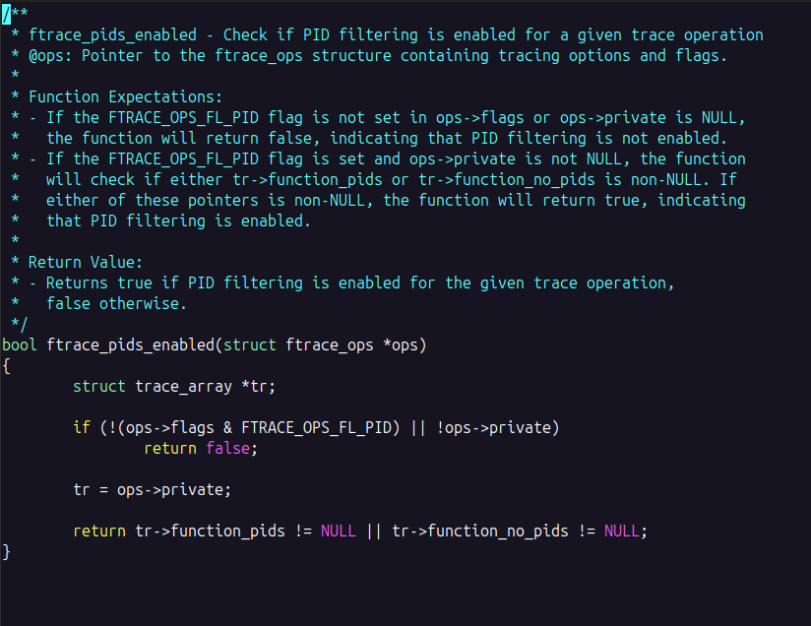
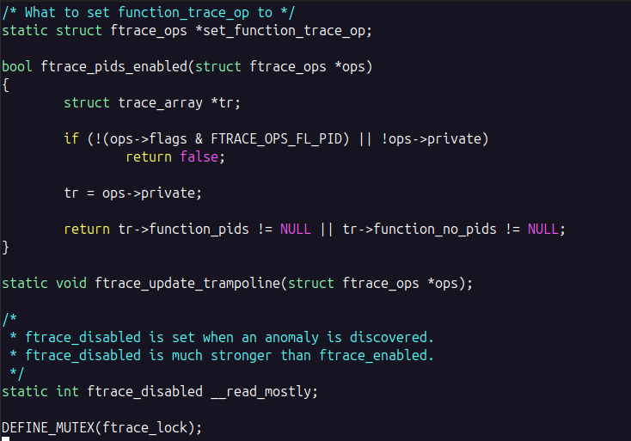
Test Run
Original undocumented source
Documented function

Slide 26
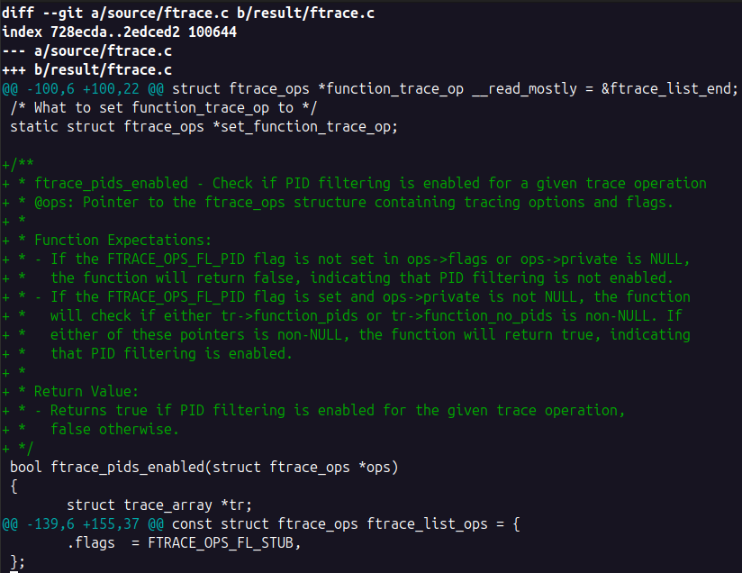
Test Run (cont.)
Documented function
Resulting patch

Slide 27
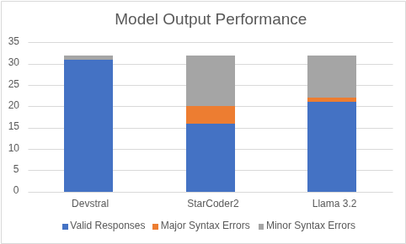
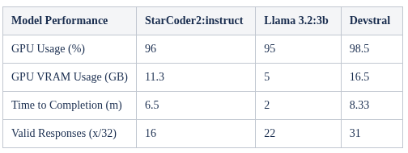
Model Comparison Results
.
Open-source models match closed-source performance
Llama 3 and StarCoder2 performed comparably to the GPT models in the high-level documentation tasks
Completeness scores demonstrated minimal performance gaps across model families
No strong link between metrics and documentation quality
No correlation between parameters, size, or speed and documentation accuracy
Qualitative metrics remained the most reliable indicators
Three main models were all viable candidates
Llama, StarCode, and Devstral were all roughly consistent
All demonstrated maturity and capabilities for document-related LLM tasks
Devstral showed highest validity in testing
Produced most syntactically correct outputs
Outperformed Llama 3.2 and StarCoder2 despite higher resource usage
.
Model Performance | StarCoder2 | Llama 3.2 | Devstral
GPU Usage (%) | 96 | 95 | 98.5
GPU VRAM (GB) | 11.3 | 5 | 16.5
Time to Completion (m) | 6.5 | 2 | 8.33
Valid Responses (x/32) | 16 | 22 | 31

Slide 28
Next Steps

Slide 29
Current Limitations
Model limitations
Inconsistent mapping between natural-language and kernel-level code
Difficulty maintaining context across large, multi-file subsystems
Technical gaps
Requirements to code traceability not fully automated end-to-end
No reliable SPDX relationship extraction or metadata generation
Operational constraints
Heavy SME involvement still required for validation
Training require kernel-specific datasets that are still being gathered and worked on

Slide 30
Next Steps
Further prompt refinement
Improve prompt specifically for code generation, summarization, and compliance tasks
Address known failure patterns (hallucinations, ambiguity, and edge-case handling)
Investigate multiple training pathways
Compare LLM fine-tuning, real time look up, and hybrid approaches
Benchmark further to identify best performing LLMs
Ongoing collaboration with maintainers
Validate generated output formatting, structure, and correctness
Incorporate upstream feedback into model to reduce reviewer workload and rework cycles
SPDX-driven requirement tracing
Generate SPDX metadata tied to code regions
Establish traceability from requirements to code blocks all the way to SPDX artifacts

Slide 31


GitHub Repos
.
.
lamacoop-docgen
lamacoop-jenkins
Python scripts for automating code documentation using LLMs
Open to contributors of all experience levels
https://github.com/vesllc/lamacoop-docgen
Jenkins pipeline script used to automate build, test, and deployment processes
Open to contributors of all experience levels
https://github.com/vesllc/lamacoop-jenkins

Slide 32
Questions?

Slide 33
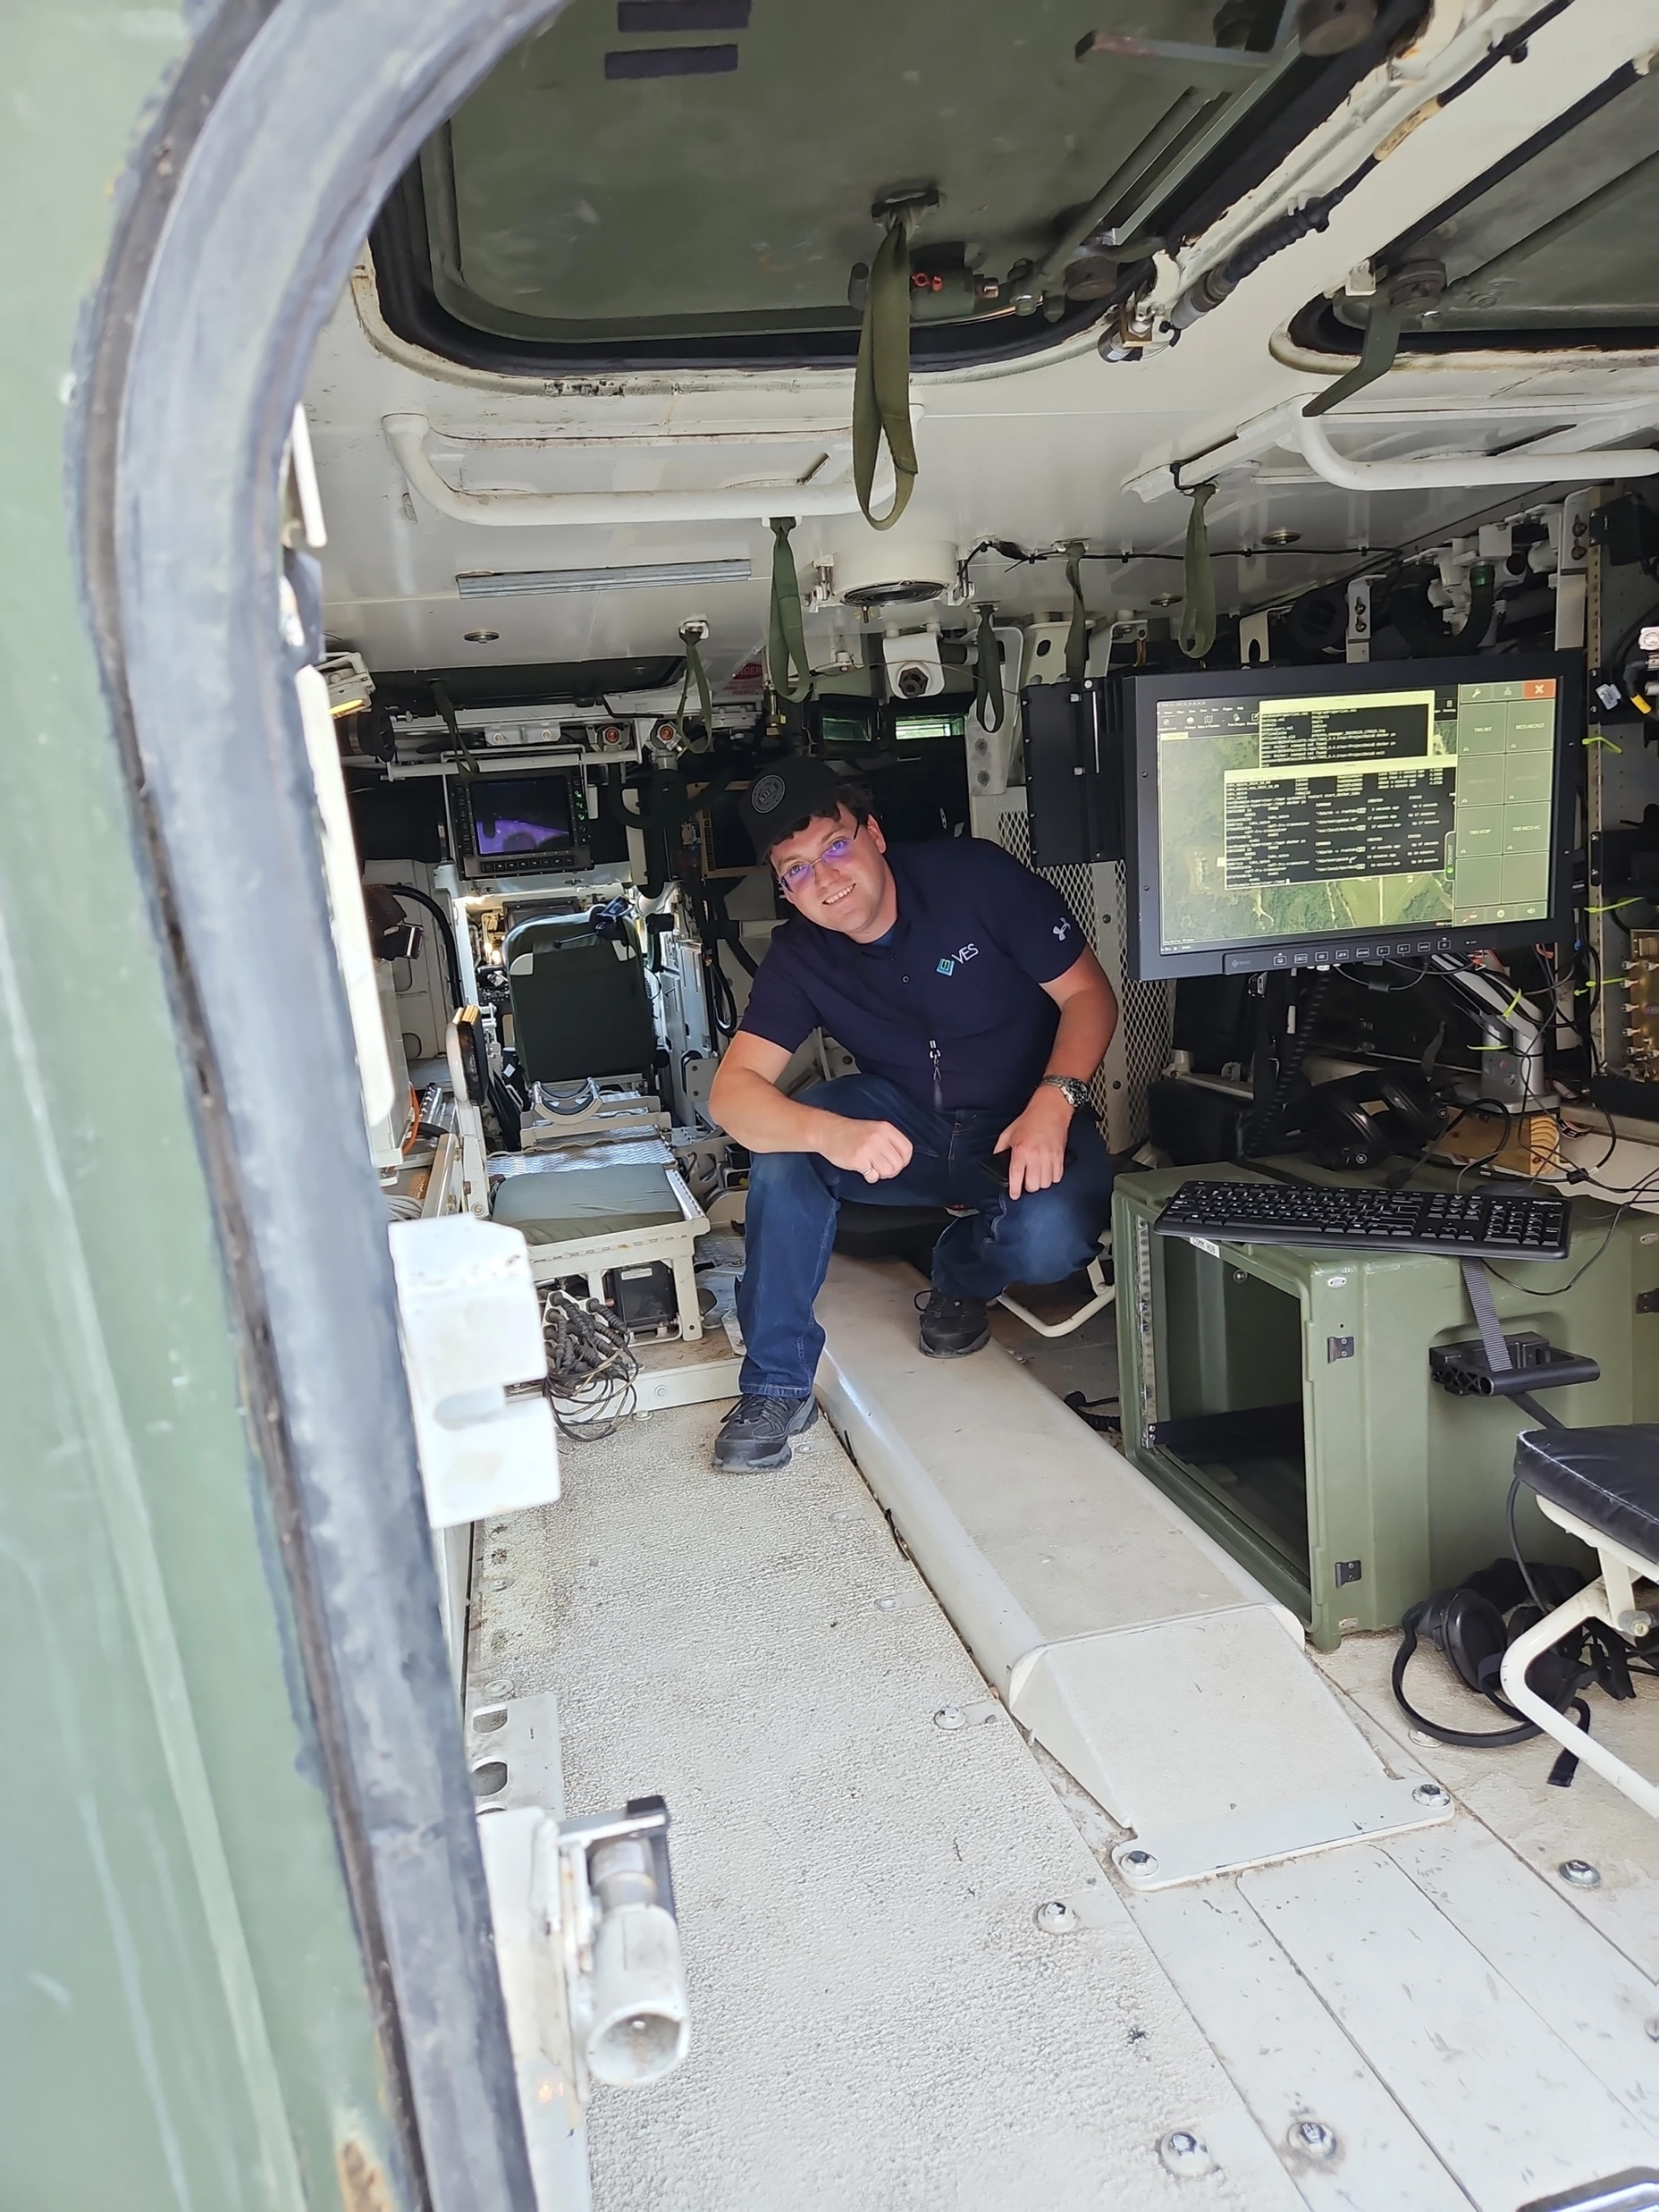




Thank You.
ves.solutions
info@ves.solutions
6180 Guardian Gtwy Ste. 102 Aberdeen Proving Ground, MD 21005

