Slide 1


Slide 2
Memory management challenges for ML/AI and HPC Rajneesh Bhardwaj (AMD), Paul Blinzer (AMD)

Slide 3
Scope
Applications benefit from cache coherent access to host-shared, dedicated accelerator memory operating as “ordinary RAM”
e.g. HBM RAM for GPU, NPU, AIE, FPGA, … ) used as “malloc memory"
The accelerator is just another processor with a funny instruction set
But may use different memory page size or management policy
Memory is reserved for specific data or other use restriction for general OS and application use
Aim for today:
Introducing the challenges using cc host accessible accelerator RAM
This affects primarily GPU, but other accelerators are affected too.
Outline design options for platform to integrate cc host RAM for accelerator use
Discuss options to align on a general platform approach …

Slide 4
Driver Managed RAM
This is one way and how some do it, but...
Platform-specific knowledge needed in driver to detect memory range(s)
Platform, kernel and driver co-dependence,
Each IHV/OEM must integrate similar support in their drivers, not a general platform solution
Legacy kernel support requires backporting/rebuilding
Driver must update OS memory management structures to include into NUMA and RAS
Uses driver/memory hotplug to register accelerator RAM, patch up NUMA and distance info
Virtualization scenarios require Hypervisor and guest OS to trust vendor-specific driver code
And guest, drivers and Hypervisor must trust each other to manage this...

Slide 5
Specific Purpose Memory
Another is using Specific Purpose Memory from Platform definition
UEFI defines "specific purpose memory" attribute (EFI_MEMORY_SP)
Architectural way for platform to declare such ranges
Combines with all other UEFI cache and memory attributes
OS doesn’t use that RAM for general allocations
Fits with existing firmware/ACPI NUMA and RAS infrastructure
Platform may support multiple different SPM ranges/drivers
Each with their own specific memory management policy
This is used in shipping AMD platforms
But on Linux, DAX stack claims all MEMORY_WB marked SPM ranges by default
Unlike other OS, requires special Linux handling
With few exceptions (see later)
Does not permit kernel modules/drivers managing specific ranges differently
From UEFI specification (2.11):
EFI_MEMORY_SP
Specific-purpose memory (SPM).
The memory is earmarked for specific purposes such as for
specific device drivers or applications. The SPM attribute
serves as a hint to the OS to avoid allocating this memory for
core OS data or code that can not be relocated. Prolonged use
of this memory for purposes other than the intended purpose
may result in suboptimal platform performance.

Slide 6
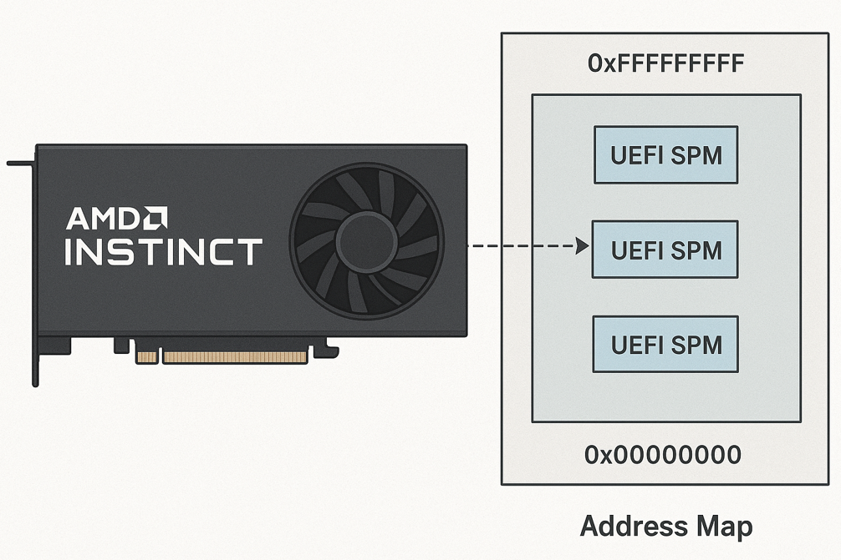
DAX claims all SPM ranges
System memory
SPM1
SPM2
Claimed by DAX stack
SPM3
SPM4
https://elixir.bootlin.com/linux/v6.18/source/arch/x86/platform/efi/efi.c#L141
https://elixir.bootlin.com/linux/v6.18/source/arch/x86/kernel/e820.c#L1327
https://elixir.bootlin.com/linux/v6.18/source/drivers/dax/hmem/device.c#L86

Slide 7
How can this be improved (part 1)?
Option 1: Declare a specific ACPI device in Firmware that references specific UEFI SPM defined range(s)
Preferred solution from an architectural standpoint
Each ACPI device has dedicated kernel driver
Uses PNP driver load for ACPI device in bootcode to claim a range
SPM ranges not claimed by ACPI device(s) are managed as-is today (would be dax application compatible)
Firmware has existing SRAT/HMAT to build NUMA relations with SPM
Firmware has existing ACPI interfaces for RAS event reporting with OS on SPM
Easy to integrate new types of memory and accelerators without further kernel changes
Driver managed memory itself or delegate to OS “device RAM” module with particular policy
Other SPM use cases (e.g. Storage Class Memory) use similar approach already.

Slide 8
How can this be improved (part 2)?
Option 2: interface between DAX stack and other kernel modules to claim specific SPM ranges (variant of option 1)
Kernel loads ACPI driver module then it…
Uses interface to discover and claim its SPM range for exclusive driver use from dax stack, removing it from DAX use
Negative: builds co-dependence between dax stack and (potentially several) accelerator drivers
Option 3: Use CXL-related structures in platform to declare accelerator ranges(CDAT)
Platform declares dedicated memory ranges through CXL defined ACPI structures for (device) attached memory
Even though the underlying infrastructure may not be CXL
Requires Firmware /OS to recognize that, yet still use these to integrate into other Firmware/OS tables (SRAT, etc)
Does have challenges with some CXL specific requirements (e.g. CDAT mailbox reg)
Option 4: Is there an option 4 ???

Slide 9
Some more details on ACPI approach?
How would the legacy kernel handling of SPM with ACPI based approach work?
Current DAX stack uses EFI_MEMORY_SP (tagged as SOFT_RESERVED) and EFI_MEMORY_WB marked as E820_TYPE_RAM as indicator for eventual claim to memory range to provide a user space interface.
Current: block dax driver load in boot options on legacy kernels
Option: If EFI_MEMORY_WB is not reported, new kernel code would add attribute on ACPI SPM
Define a PNP driver-owned E820_TYPE_DEVICE_RAM in new kernel.
May require additional changes where E820_TYPE_RAM is referenced
compatibility across OS?
Option: ??
Old:
System memory
New:
ACPI based
SPM1
ACPIDEV_A
SPM2
Claimed by DAX stack
Claimed by DAX stack
SPM3
SPM4
ACPIDEV_B
To do this would require some changes to current Linux kernel implementation e.g.
https://elixir.bootlin.com/linux/v6.18/source/arch/x86/platform/efi/efi.c#L141
https://elixir.bootlin.com/linux/v6.18/source/arch/x86/kernel/e820.c#L1327
https://elixir.bootlin.com/linux/v6.18/source/drivers/dax/hmem/device.c#L86

Slide 10
Backup

Slide 11


