Slide 1

Notes:
Matt is presenting a Linux Product at a Linux Conference

Slide 2
KUnit Testing Insufficiencies
Notes:
Linux Product

Slide 3
Agenda
Introduction
Writing KUnit Tests
Writing KUnit Tests Difficulties (Demo)
Building KUnit Tests
Executing KUnit Tests
Executing KUnit Tests (Demo)

Slide 4
Introduction
KUnit “Insufficiencies” become apparent when:
  Writing many tests (1000 or more)
  Writing highly detailed tests
  Testing small, isolated units
The scenarios listed above are important when:
  Writing tests to verify intended function (safety)
  Writing tests to verify continued function (security)

Slide 5
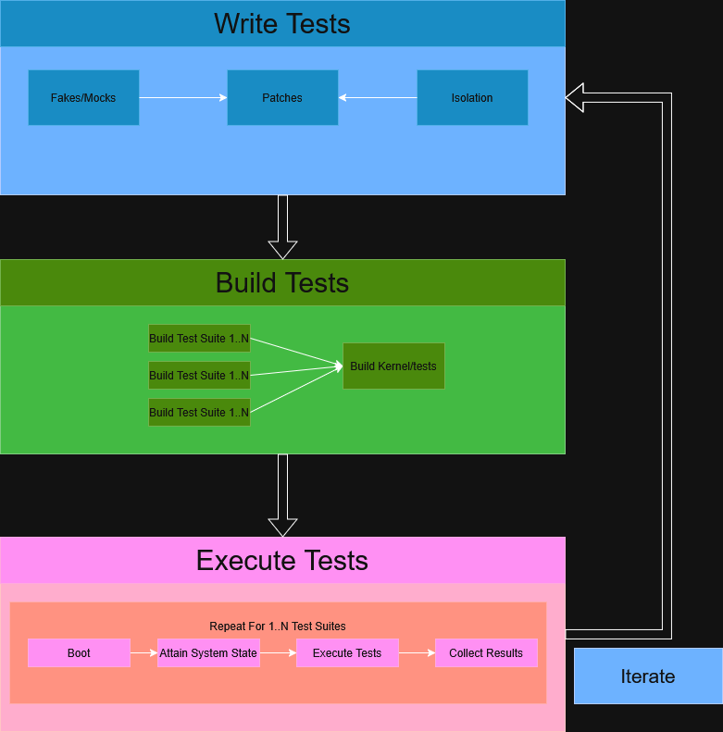
Writing Tests
Framework does not provide conventional unit test tools (e.g., faking/mocking).
Complex patching/maintenance for code isolation
The write/execute/observe cycle requires booting and executing the kernel repeatedly.
Copyright © 2025 Boeing. All rights reserved.
Notes:
© Copyright 2025 Boeing

Slide 6
Writing Tests Difficulties (Demo)
(See Code for below bullet points)
  Config Item for enable/disable tests+mock
  Makefile change to build test
  Test source important points
    Need duplicate code for various data structures etc. because we can’t include a header with these definitions
    Need to add test data to check sequence of events/calls
    Extensive additional calls needed to set up data structures (due to inability to mock)

Slide 7
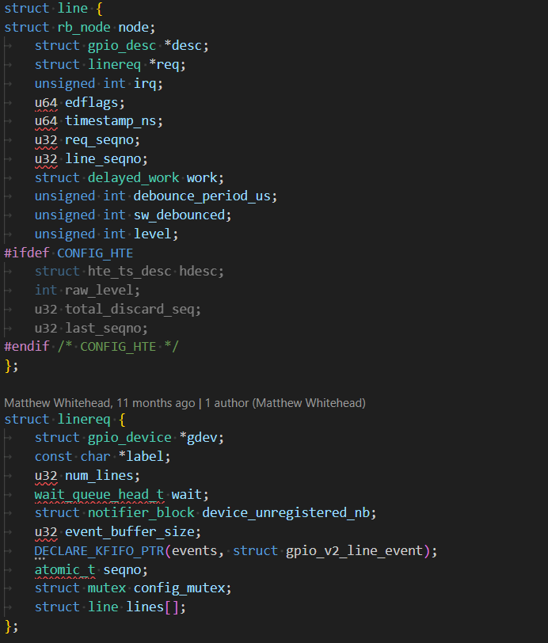
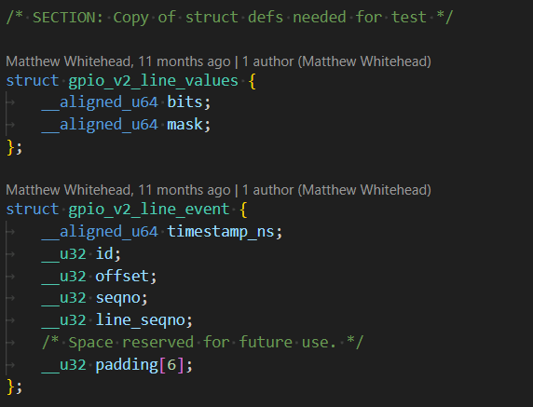

Slide 8
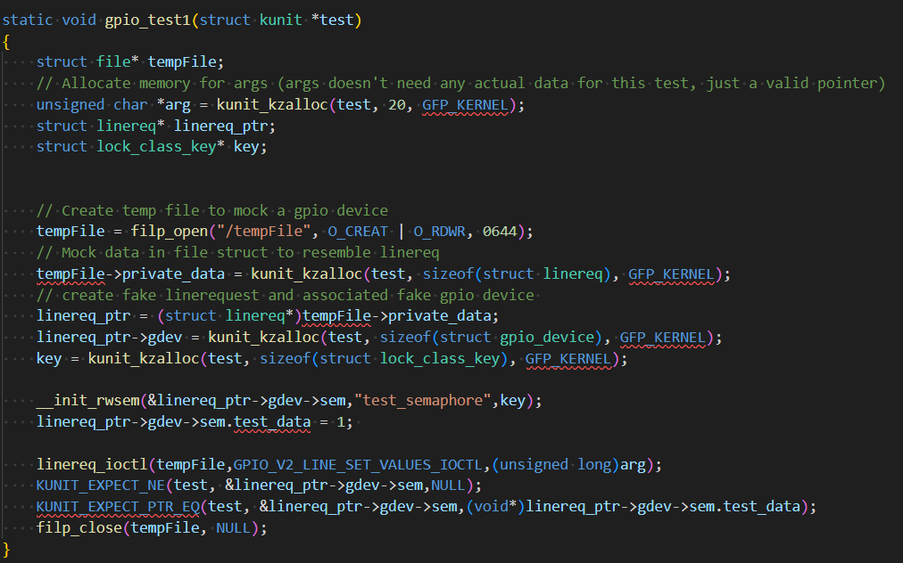

Slide 9
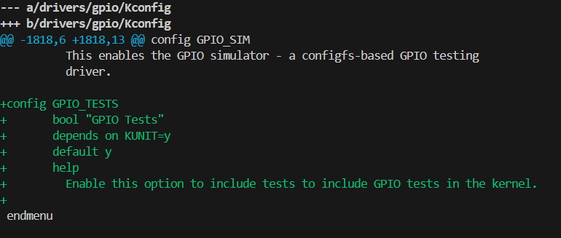
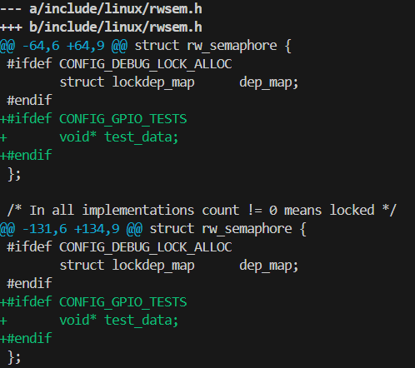

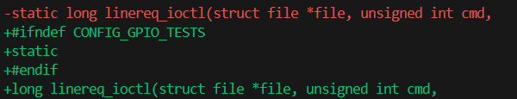
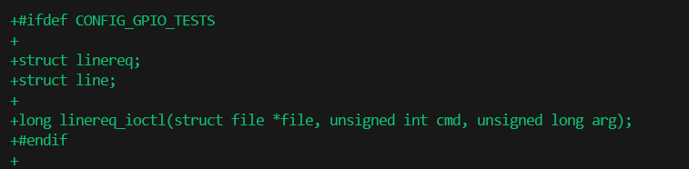

Slide 10
Building KUnit Tests
Must build the entire kernel/tests
For wide scope or many tests, many builds may be required
High time expenditure for multiple builds
High maintenance burden for many patches
Copyright © 2025 Boeing. All rights reserved.
Notes:
1. © Copyright 2025 Boeing.
2. Driving attention toward how to approach unit testing of Linux source code…(Boeing Blinx…is the Boeing direction which is consistent with this approach…)
Open source conference…working into the open source community… inherent licensing of it is open…
All documents – creative commons license – allows reuse of it to be open…

Slide 11
Executing KUnit Tests
Heavy dependencies on system states
Many tests may require many builds/boots
Long execution times compared to conventional unit tests
Requires at least emulation, if not real hardware
Automation in a build pipeline is resource heavy due to the above
Copyright © 2025 Boeing. All rights reserved.

Slide 12

Executing KUnit Tests (Demo)
Apply Patch
Add .kunitconfig for this test:
Execute: ./tools/testing/kunit/kunit.py run --arch=x86_64

Slide 13
Thank you
Matthew Whitehead
Matthew.a.whitehead@boeing.com

Slide 14
Additional Demos/Discussion
Alternative unit test method: Demo using Ceedling and testing in user space.
  Reminiscent of previous efforts running KUnit tests in User space
  Build natively or for target
  Runs natively or on target
  Fast iteration time
  Fast execution time
  Somewhat difficult setup with some workarounds, room for improvement here though.

Slide 15


