Slide 1
How big of a problem are Un-upstreamed patches?
Jon Mason

Slide 2
The Upstream Project
Project Source Code
Configure and Build
Package
Distro - Collection of packages

Slide 3
What are patches?
Modification of original source code

Slide 4
Why do we need patches?
Fix Critical vulnerabilities (CVEs)!
Fix other bugs
Add features
Integrate source code into build environment

Slide 5
What should we do with a patch?

Slide 6
The upstreaming process
Fix issue
Submit Upstream
Iterate until accepted
Patch Accepted/Release Software
Find Issue

Slide 7
Why not use only upstream?
Time delta between upstream release and distro release
Upstream won’t take it
Unique to build environment
Feature/Fix isn’t fully “baked”
Upstream is dead/no maintainer/unresponsive

Slide 8
So, we must keep patches in our distro tree?
Sure, but the upstreamed versions will make it so eventually can run only "just upstream"

Slide 9
Drive-by (Drive thru) patches in distro
Patches that are created for the distro and not submitted for inclusion upstream
These are the problem!
Whose problem are these patches? The patch submitter or the distro package maintainer
Will the upstream project ever even know there is a problem?

Slide 10
Problems of not using only upstream
Duplication of effort
Bit rot of patches

Slide 11
All of this is theoretical, right? Is this actually a problem?

Slide 12
Story of why I went down this path?
(redacted to protect the guilty)

Slide 13
So, we have patches living in our trees forever? This cannot be true...

Slide 14
YOCTO

Slide 15
Types of Patches
For nanbield (v4.3)
1186 total
200 Backport
253 Pending
452 Inappropriate
232 Submitted
19 Denied
21 Inactive-Upstream
69 CVEs?

Slide 16
Upstream-Status?
Pending
Submitted [where]
Backport [version]
Denied
Inactive-Upstream [lastcommit: when (and/or) lastrelease: when]
Inappropriate [reason]
https://docs.yoctoproject.org/contributor-guide/recipe-style-guide.html#patch-upstream-status

Slide 17
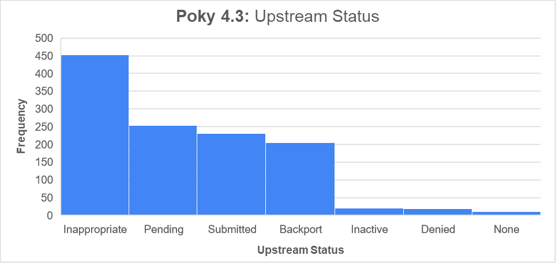

Slide 18
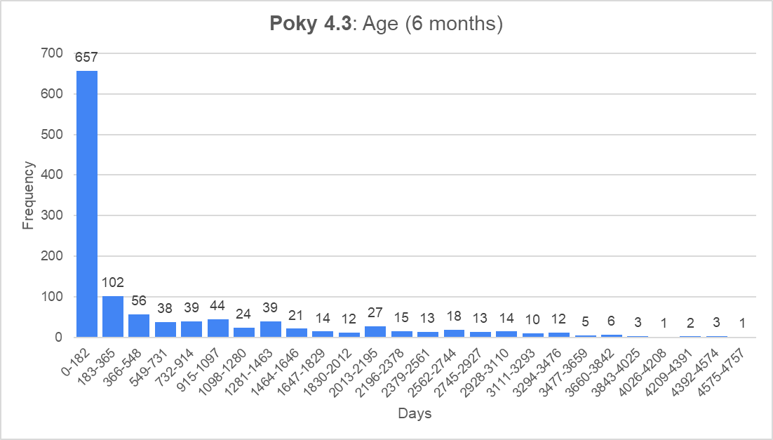

Slide 20
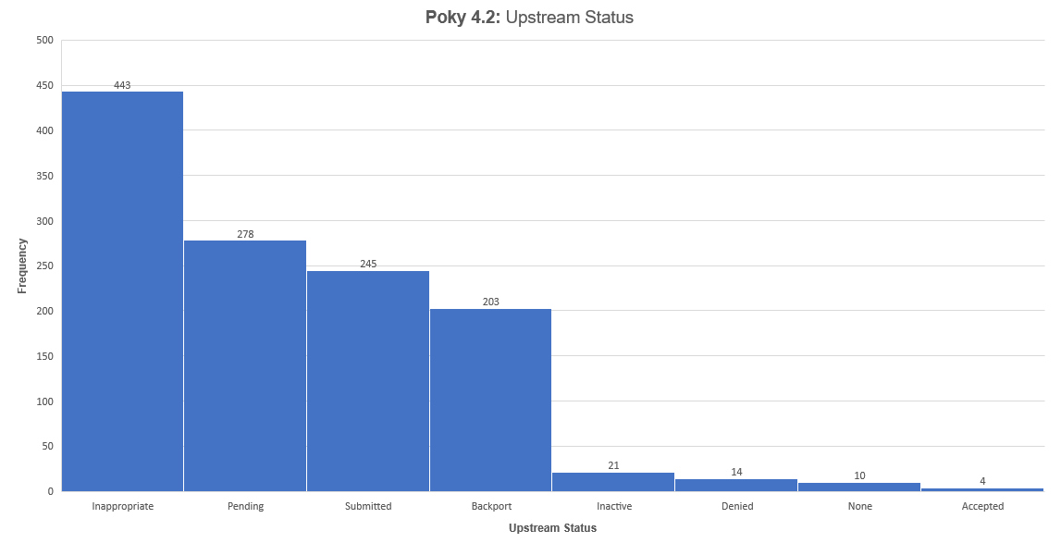

Slide 21
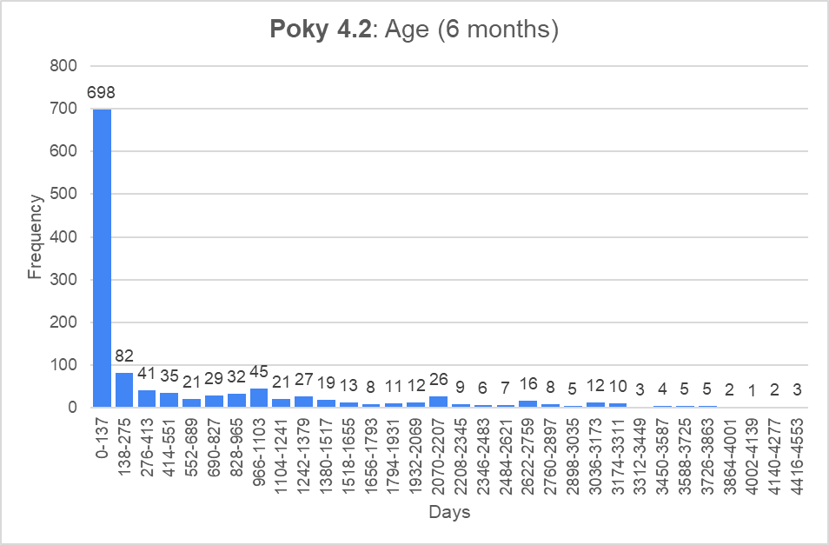

Slide 23
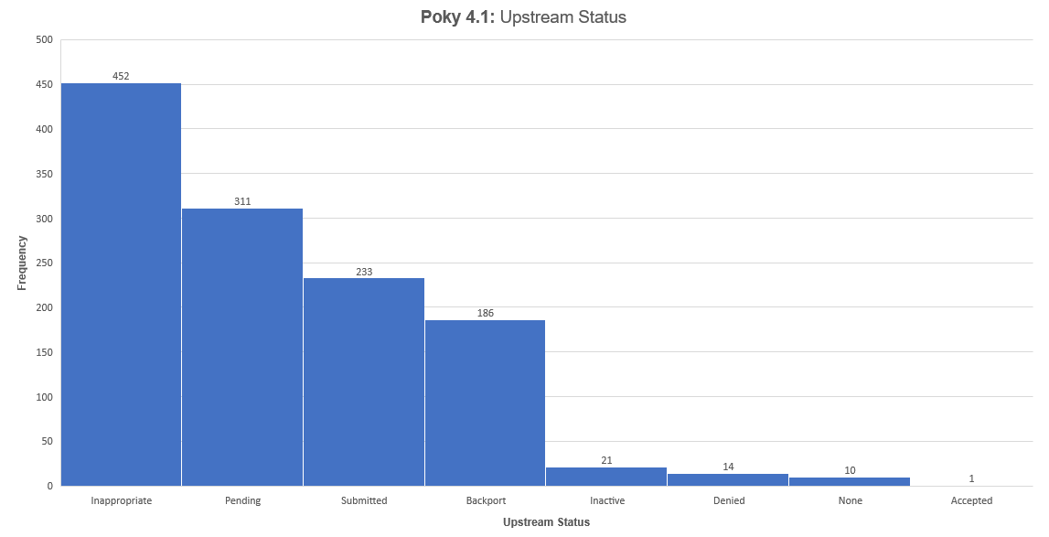

Slide 24
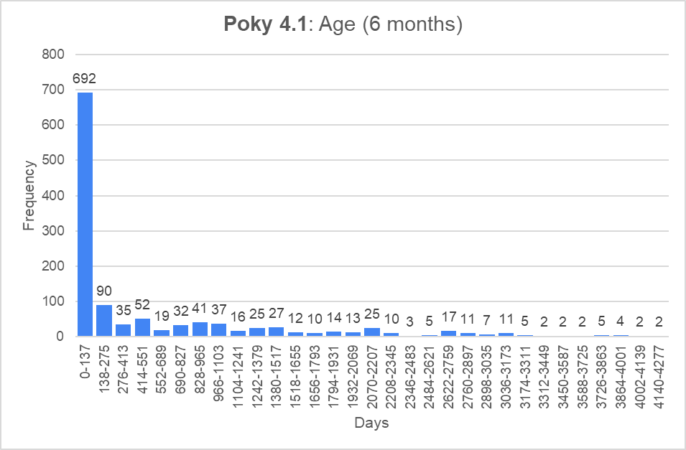

Slide 26
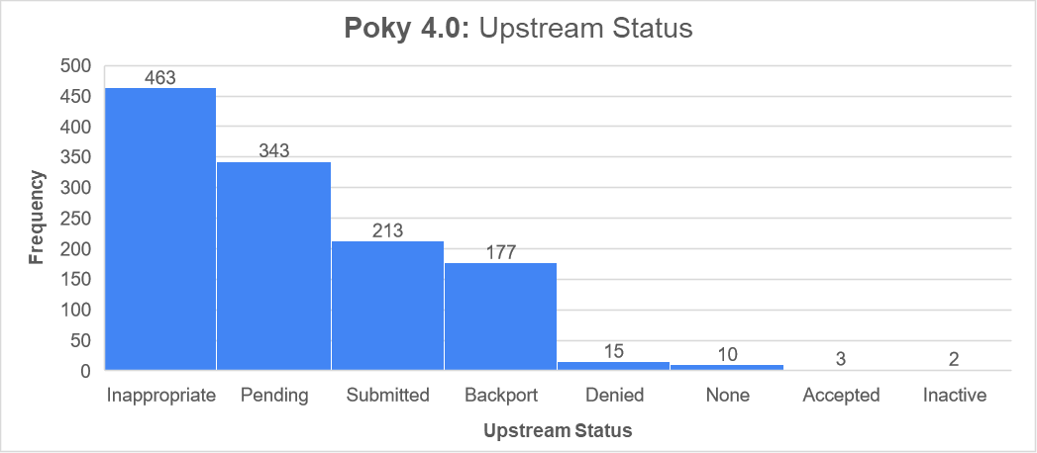

Slide 27
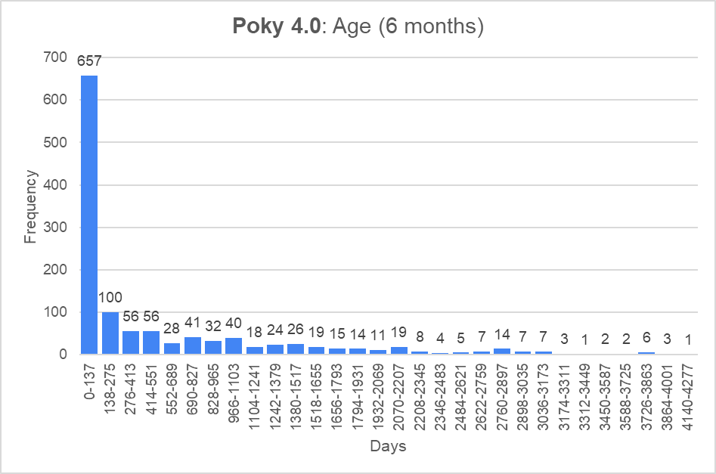

Slide 29
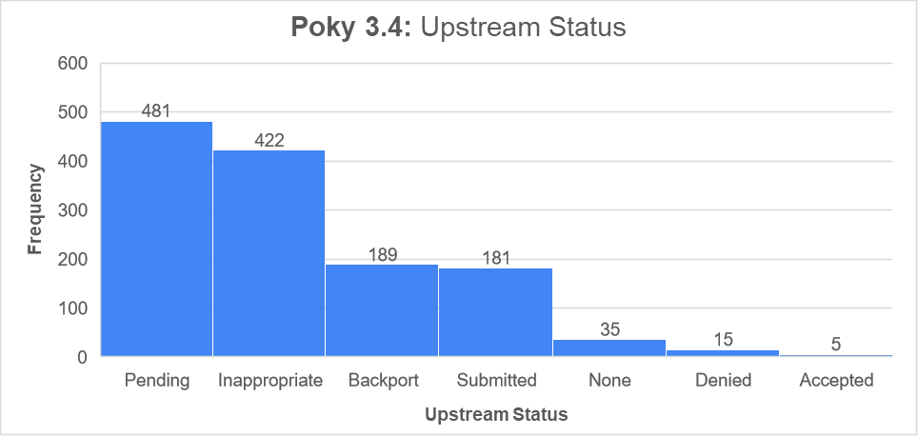

Slide 30
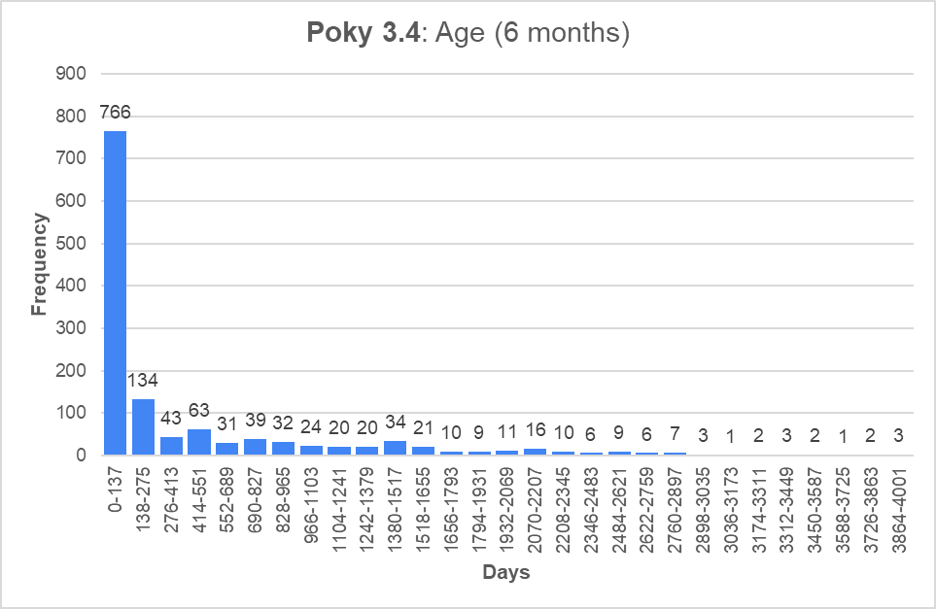

Slide 32
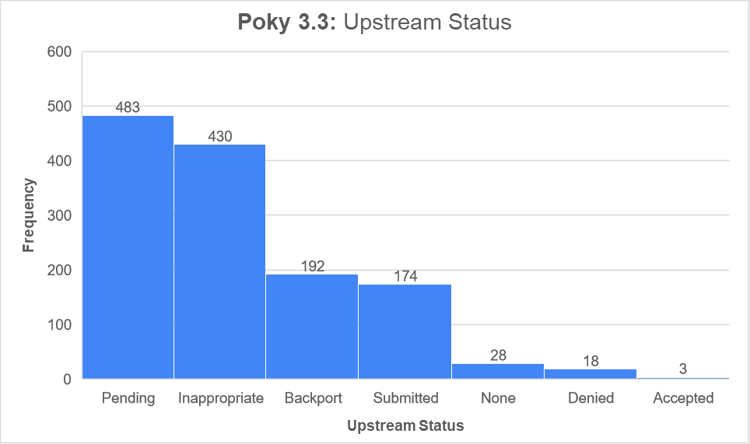

Slide 33
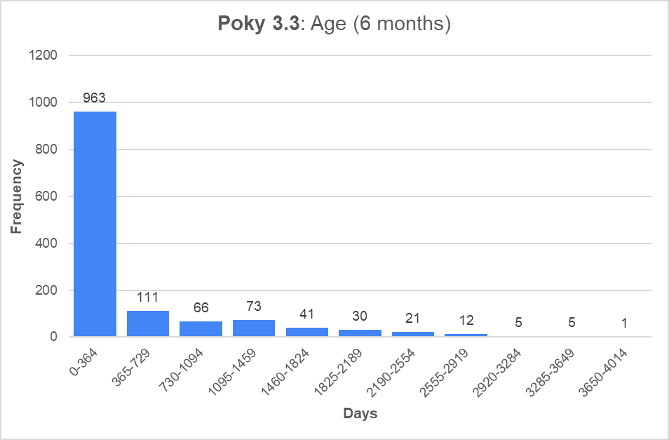

Slide 35
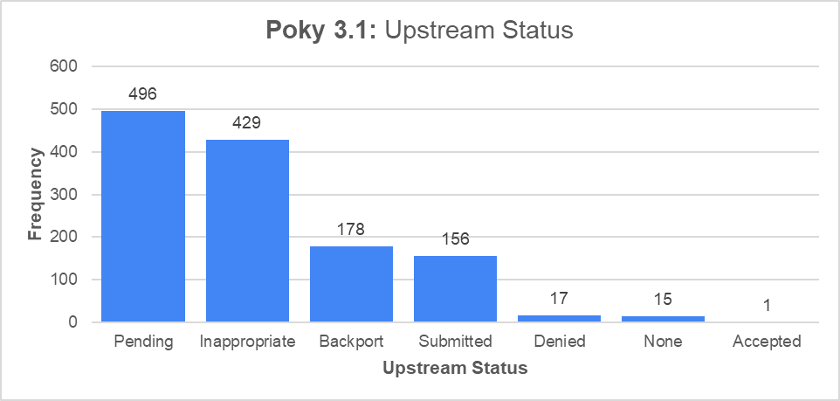

Slide 36
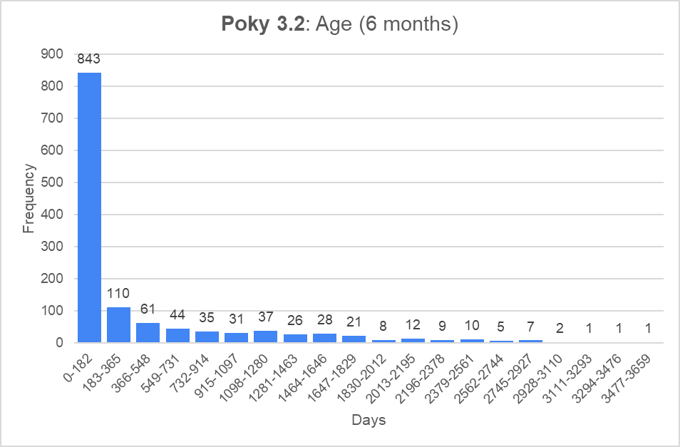

Slide 38
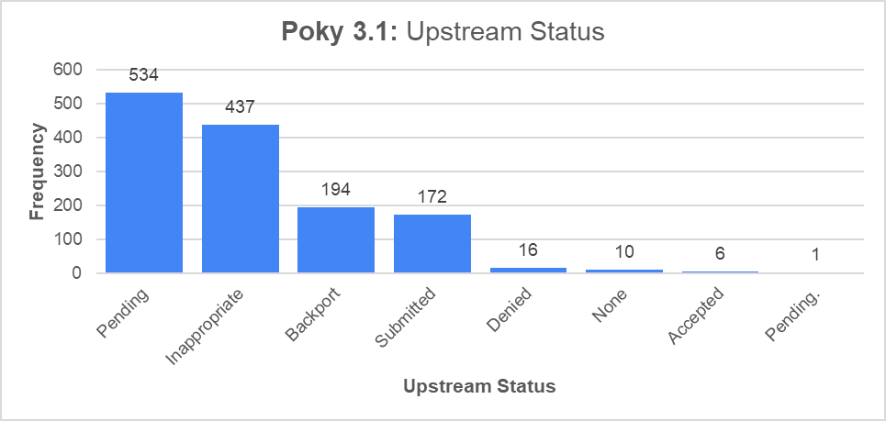

Slide 39
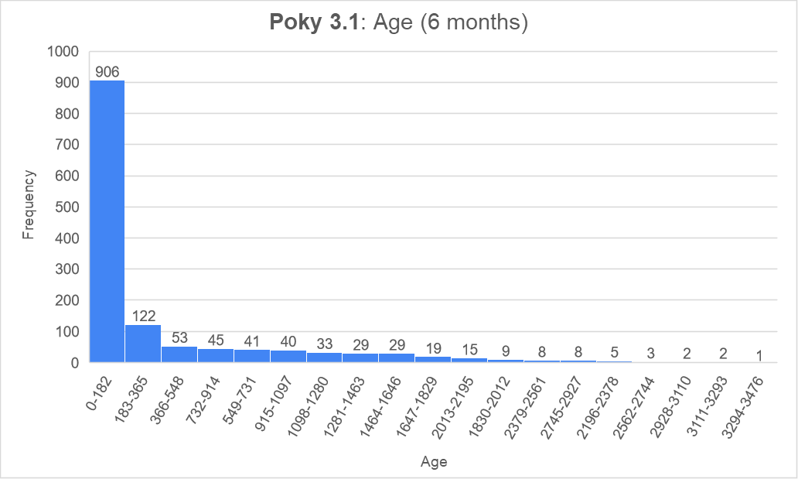

Slide 41
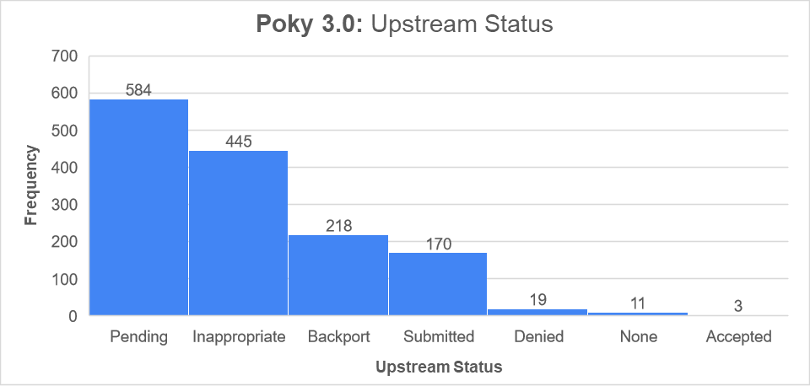

Slide 42
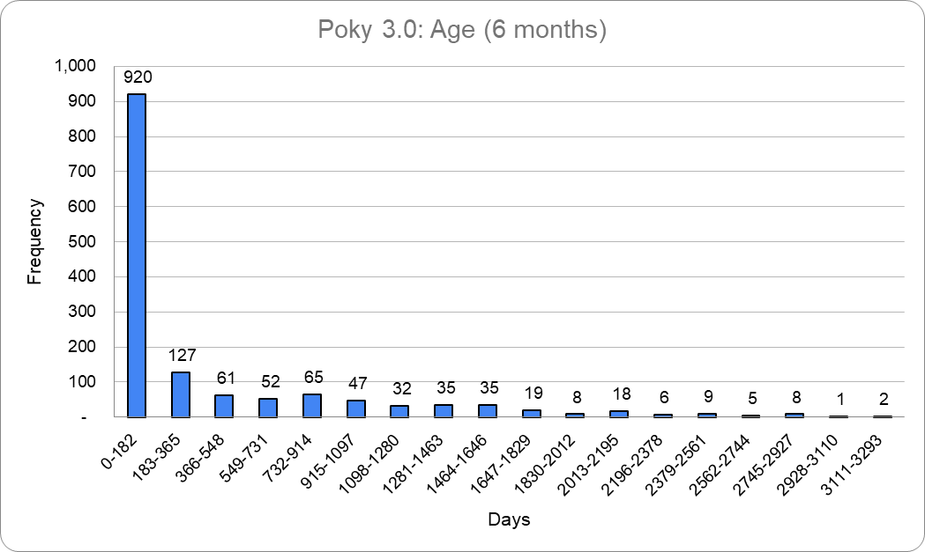

Slide 43
BUILDROOT

Slide 44
Types of Patches
For 2023.08.02
1643 Patches
35 with Upstream-Status set
2 with CVE

Slide 45
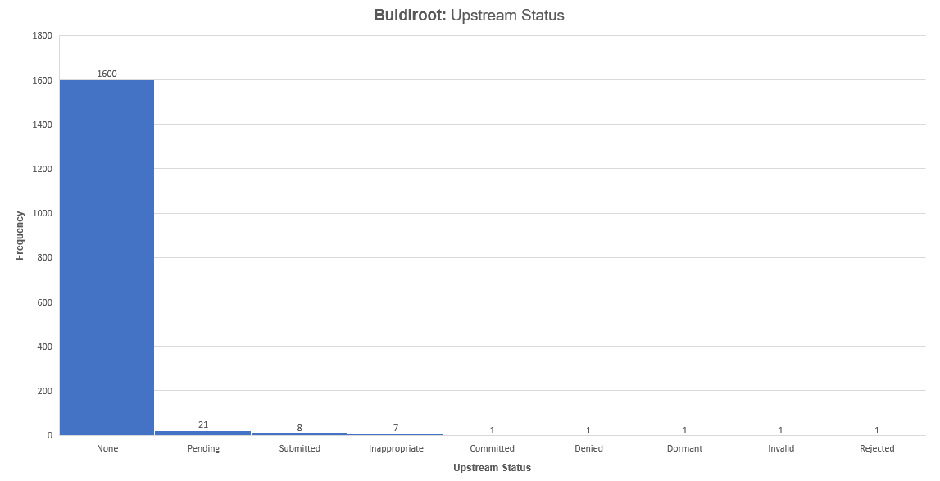

Slide 47
Fedora

Slide 48
Types of Patches
Release 36
17618 patches
13 CVEs
2 Upstream-Status

Slide 49
Things we can commonly fix to track this issue:
Adopt to using patches that are generated via `git format-patch` or similar so that we have an actual date to see how old these things are; better yet use git
Add an Upstream-Status field (or similar) to know if the patches in question should be upstreamed

Slide 50
Stretch goals:
Only allow patches in that have been submitted, perhaps even accepted

Slide 51
Questions?

Slide 52
What is YP doing better than others and what can we learn/improve on?

