Slide 2
Plumbing challenges in Dynamic Capacity Devices
LPC CXL micro conference 2023 Navneet Singh, Ira Weiny, and Jonathan Cameron
Notes:
Jonathan

Slide 3
Agenda
Introduction
Asynchronous add/release of memory
Partial extents
Interleaving flow challenges
Force release support
Host user interactions
Backup
Memory sharing
Notes:
Jonathan

Slide 4
What are we after?
Highlight the challenges brought in by CXL 3.0 DCD feature
Identify Industry use cases
Ensure User APIs provide for those use cases
Open discussion/feedback/suggestions
Other?
Notes:
Jonathan

Slide 5
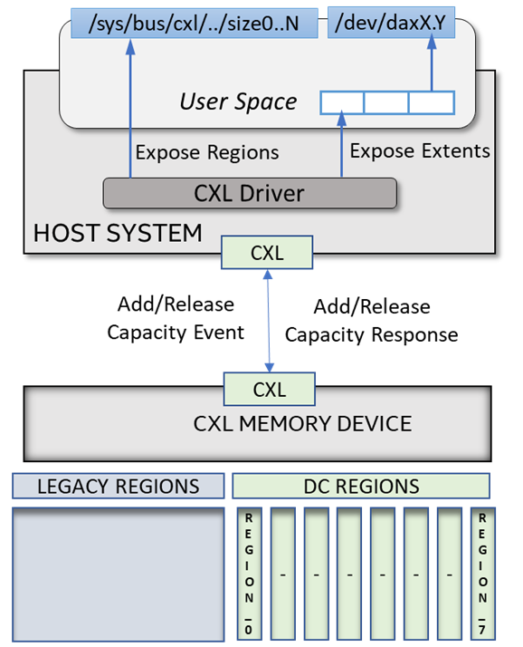
CXL Dynamic Capacity Device Introduction
Dynamic capacity device is a CXL3.0 feature which allows memory capacity to change dynamically without host system restart​
CXL device can have up to 8 Dynamic Capacity regions per host​
Dynamic capacity is added/released in a form of memory extent which is defined with start address, length and user tags​
CXL device maintains extent list per host ​
Dynamic capacity add/release operation are triggered through Fabric Manager​
Dynamic capacity at the host is provisioned as DAX device
Notes:
Navneet

Slide 6
Asynchronous DC Memory Release
User pinned memory ​
Complete or Partial Extent Memory not released on DC release memory request as its in the use.
Once memory is free then it needs to be returned to the device asynchronously
Based on in use device dax mappings​
Kernel Pinned memory​
Complete or Partial Extent Memory not released on DC release memory request as its pinned in the kernel
Memory released when mapping is released (unlikely to happen)
Notes:
Navneet

Slide 7
Partial extents
Any strong use case in Linux?
Spec allows
the device to request release of sub-extents
(vs what was previously added)
the host to accept part of an extent offered from the device
sub-extents not supported for now
[based on discord discussion]
Notes:
Navneet

Slide 8
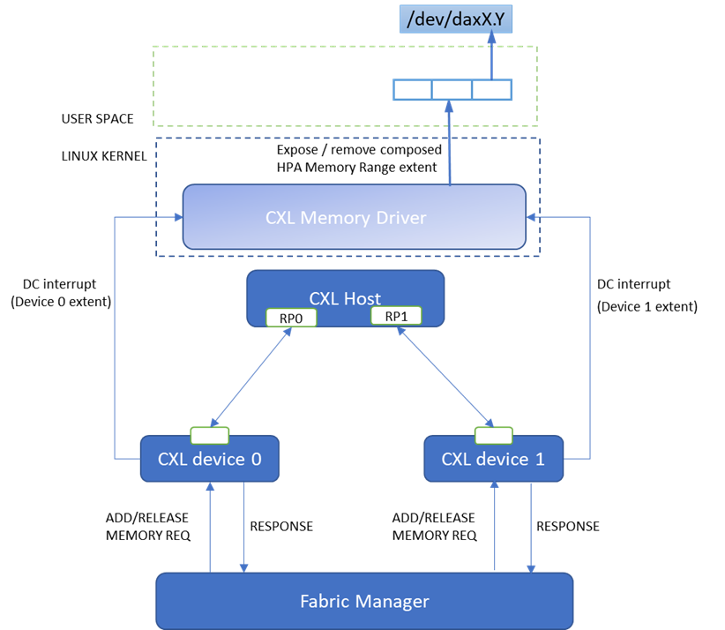
DCD Interleaving Challenges
Runtime construct/destroy the memory range from the interleaved memory devices extents notified through DC add or release interrupts.​
Extent Add - Once Interleaving set is complete after receiving the last add extent from the interleaved memory device, It’s driver will construct the HPA range, surface the extents to the user space after the last extent.​
Extent Remove- First release extent from the interleaving will leads to removal of interleaved memory range extent from user space.
Notes:
Navneet

Slide 9
Forced Dynamic capacity support
If memory is pinned for long time, then device can raise forced dynamic capacity release request
Device will not wait for the response and will remove the memory
Any access to that memory by the kernel will lead to poison
Force ignored by Linux software
[dev_err_ratelimited()]
Extent is leaked
Probably will require host reboot…
Notes:
Navneet

Slide 10
Traditional DAX regions
DAX Regions are created on existing memory
DAX devices are created linearly
DAX devices can map different ranges within the region
Limited control over exactly where the DAX ranges are
DAX dev
DAX dev
DAX dev
DAX range
DAX range
DAX range
DAX range
DAX Region
Notes:
Ira

Slide 11
Sparse DAX regions
Created as a ‘container’ for potential memory
Concept similar to the DC Regions
DAX device creation initially still linear
But can adapt to more control [tags?]
DAX dev
DAX dev
DAX dev
DAX range
DAX range
DAX range
DAX range
DAX Region
DAX region extent
DAX region extent
DAX region extent
Notes:
Ira

Slide 12
Git trees
In review
Kernel
RFC v3 soon…
Discussions on discord
QEMU
https://lore.kernel.org/all/20231107180907.553451-1-nifan.cxl@gmail.com/
https://gitlab.com/jic23/qemu/-/commits/cxl-2023-11-02
Notes:
Ira

Slide 13
Backup

Slide 14
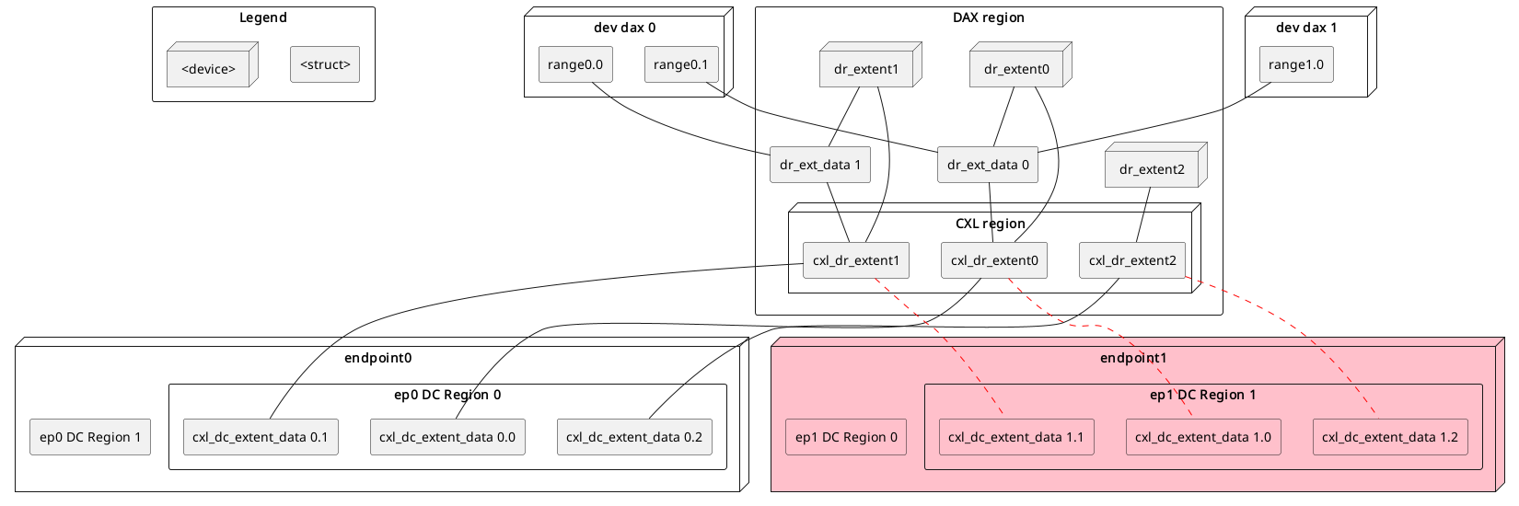
DCD internal arch

Slide 15
Extents
What is an extent?
A range of memory in region block size chunks
Multiple ‘extent’ objects in the code
DC extent
CXL DAX Region extent
DAX Region extent

Slide 16
Dynamic Capacity Extent acceptance
should a region be required for memory accept?
spec requires region
ensures CFMWS and decoder availability prior to memory acceptance
allows for more flexible interactions with the host/orchestrator/FM
Notes:
Navneet

