Slide 2
move_pages() for physical addresses: move_phys_pages()

Slide 3
Thesis
CXL Hardware vendors (esp. 2LM) asking what work can be offloaded
Proposals for a variety of offloaded monitoring features
Examples: Heatmaps, IDLE bits, hotness lists, access locality info
The Problems:
Devices talk Host Physical Address or Device Physical Address (0-base)
No userland phys-addr migration interface. No hardware standard.
move_pages: Uses virtual addresses, requires pid

Slide 4
Why do we even want to do this?
Current State of Tiering
Interception/Code Changes (“legacy optane” methods)
IBS/PEBs based monitoring (sampling, provides HVA and/or HPA)
Transparent Page Placement – TPP and AutoNUMA (charging/faults)
Page/Folio flag monitoring. (IDLE Bitmap. PFN based)
Systems like DAMON already use a large variety of these techniques
All of these have a variety of performance or functionality issues.

Slide 5
IBS/PEBs (Sample-based)
Most common sampling metric: LLC Cache Misses
HVA/HPA + PID
Address to node is queried tracked
The Problems
Prefetch traffic is captured differently (or potentially missed)
Runtime overhead based on sample rate
PMU counters often already in use (shared/unavailable)

Slide 6
Transparent Page Placement (TPP)
Primary Mechanism: Fault Based
Mark some pages not-present, catch the fault, demote cold pages
Recent extension for promotion based on lower tier fault detection
Additional extensions pushing to avoid fault overhead.
Problems
Fault overhead / Tail latencies.
Can be complicated to tune depending on workload.

Slide 7
IDLE-bit Tracking
Mechanism: (struct page)->flag & PG_idle - now in folio
User can mark PFNs as idle/not idle.
Presumably updated by the kernel to denote a PFN not idle.
Problems:
Presently appears broken from user space due to transition to folios
PFN-based lookup
Still requires a virtual-to-physical translation (proc/pagemap)

Slide 8
Proposed: Offloaded Page-Tracking
Why: Devices w/ multiple layers of memory. (DRAM + SSD + Network)
Idea: 2LM (DRAM+SSD) offload page faults. Use data to promote.
Mechanisms: IDLE, Heatmap, Hotness list, etc – you name it
The Big Problems
Devices have no concept of tasks / virtual memory
Physical/Device Addressing – reverse lookup is very expensive
No Standard Interface: Hard to build core kernel support.

Slide 9
Reverse Lookup Overhead
Question: How bad is a reverse-lookup?
Must convert HPA to HVA to use move_pages
No direct interface, so have to build a map for all tasks using the node.
Contrived Test:
Run 4-48 memory hogs @ different capacities and system load.
Use proc/pid/maps and proc/pid/pagemap to build reverse map
Measure build/merge time of reverse maps. (Time to time to insight)

Slide 10
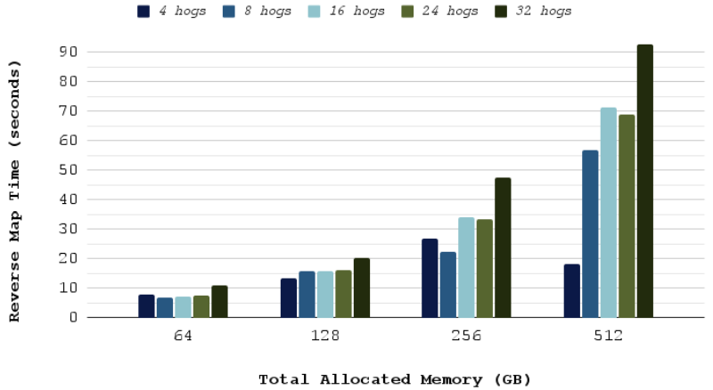
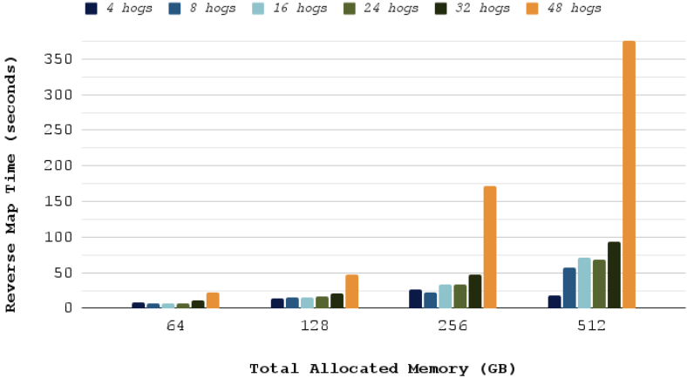
Test Results
Map build time increases ~linearly w/ capacity, and non-linearly if tasks > cpus
Hitting /proc/pagemap aggressively
move_phys_pages would alleviate these overheads and reduce time-to-action
ONLY GOOD FOR ONE SNAPSHOT IN TIME

Slide 11
Offloaded Tracking limitations
Hardware has no contextual information about a page
“Physical Page” could be re-used rapidly (process creation/death)
Transparent Huge Pages
Many unknowns due to Chicken/Egg Situation:
No tracking offload implementations in hardware.
No interface because no ("acceptable") use case.

Slide 12
Move_phys_pages implementation
Working branch based on v6.6 @ my github
move_pages(pid, count, pages, nodes, status, flags)
remove pid: move_phys_pages(count, pages, nodes, status, flags)
Re-use move_pages code: 2 commits + documentation
1 commit refactor, 1 commit to implement syscall
Does the reverse lookup anyway, but efficient (HPA -> Folios)
Validates addresses are valid and movable

Slide 13
Validating Movability
Per page: rmap_walk(folio, &rwc);
static bool phys_page_migratable(struct folio *folio, struct vm_area_struct *vma, unsigned long address, void *arg)
Walks each VMA that maps the page and determines migratability
cpusets intersection (same as move_pages)
vma_migratable (same as move_pages)

Slide 14
Other ideas and Feedback
Create the interface, but not the syscall
Allows core and drivers to make use of it, but not userland
Issue: Allows development, but only in drivers. May hurt adoption.
Issue: May not encourage open development and standardization.
"Userland shouldn't talk physical addresses, because security"
IBS/PEBS can already be configured to give HVA to HPA mappings
This would be a CAP_SYS_ADMIN only interface

Slide 15
questions

Slide 16
References
gmprice/linux at sys_move_phys_pages_11_9 (github.com)
[RFC v2 0/5] move_phys_pages syscall - Gregory Price (kernel.org)
[2206.02878] TPP: Transparent Page Placement for CXL-Enabled Tiered-Memory (arxiv.org)
[RFC PATCH 0/5] Memory access profiler(IBS) driven NUMA balancing (kernel.org)
Towards an Adaptable Systems Architecture for Memory Tiering at Warehouse-Scale (micahlerner.com)
Memtis: Efficient Memory Tiering with Dynamic Page Classification and Page Size Determination (acm.org)
HW counters for hold/cold pages - Aneesh Kumar K V, Wei Xu
DAMON updates and future plans - SeongJae Park
Authors
Gregory Price
Svetly Todorov
MemVerge Inc.

