Slide 1
Kuankuan Guo
kuankuan.guo@foxmail.com

Slide 2
ZonedStore:
A zone-aware cache system
for distributed databases

Slide 3
Contents
1. Motivation
2. Problems
3. Solution
4. Benchmarks
5. Conclusion

Slide 4
1. Motivation
Query Engine
Query Engine
Lower Cache-miss Rate
- The read/write granularity of the remote storage is relatively large (e.g. 2MB), so a we cannot bear a high cache-miss rate.
- Larger local storage could provide much better cache hit rate
Predictable Performance
- Latency spikes is not acceptable, because for large scale internet products, the data pileline is so long that one spike could cases significant impact
- Thus, read and write amplification could be well resolved
Lower-Cost
- We also adopted persistent memory in some critical services, but its capacity still cannot beat SSD
- We need predictable performance & higher cache hit rate, thus PMEM may not the best choice (and it costs a lot)
Data Store
Data Store
Data Store
QE Pipeline
QE Pipeline
QE Pipeline
Local Cache
Local Cache
Local Cache
DRAM
DRAM
DRAM
SSD
SSD
SSD
Remote Storage System (HDFS/OSS/etc.)
Hybrid Serving & Analytical Platform
(Data Path)

Slide 5
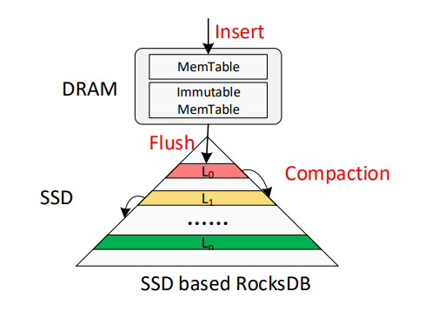
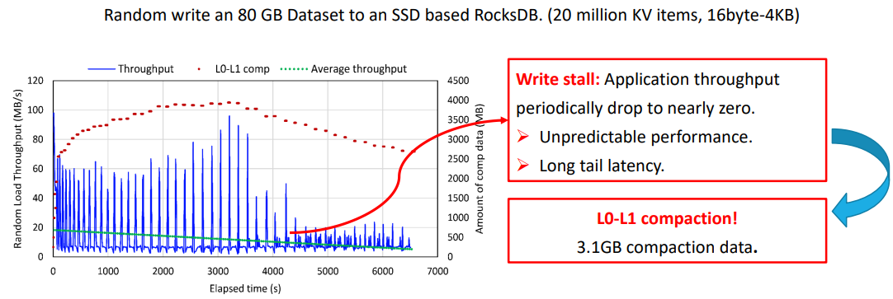
2. Problems of Previous Solution
We previously use TerarkDB (a fork of RocksDB, LSM-Tree)
Lots of Latency Spikes
- Background compactions may affect user thread, which leads to write latency spike
- All levels in the multi-layer LSM-Tree may need to be read for a single read, which causes read latency spikes (read amplication)
Low User-side Throughput
- Write amplification includes: WAL & MemTable Flush (2X), Compaction(3~10X) and file system WA(> 1.5)
- User-side throughput is less than 150MB/s (Disk-side > 600MB/s, random write)
Space Amplification
- LSM-Tree & EXT4 cannot provide predictable space usage, thus we have to keep at least 10% user space (and disk OP is not counted)
Yao, Ting, et al. "MatrixKV: Reducing Write Stalls and Write Amplification in LSM-tree Based KV Stores with Matrix Container in {NVM}." 2020 USENIX Annual Technical Conference (USENIX ATC 20). 2020.

Slide 6
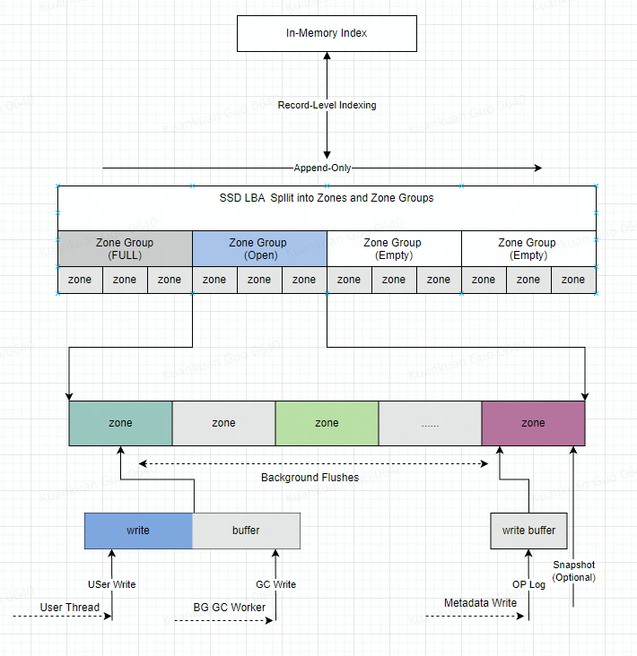
3. Solution - Ideas
In-memory Metadata & Record-Level Indexing
- Record size is usually larger than 100KB (PMEM & DRAM provide smaller access granularity), key size: 8 ~ 16B
- So 8 x 8TB requires about only 10 ~ 20GB memory
- No read amplification (a single IO for each record)
Zone-based Append Only IO Model
- Limited write point (for both Conv SSD & ZNS SSD)
- Background GC also need to follow this rule
User Managed GC
- We could easily predict the space required for GC, so we can use almost all of the disk space (99% percent in our cases)
Emergency Data Sacrifice
- Sometimes the space prediction may not work as expected, so we will remove valid data even they are not supposed to be evicted yet

Slide 7
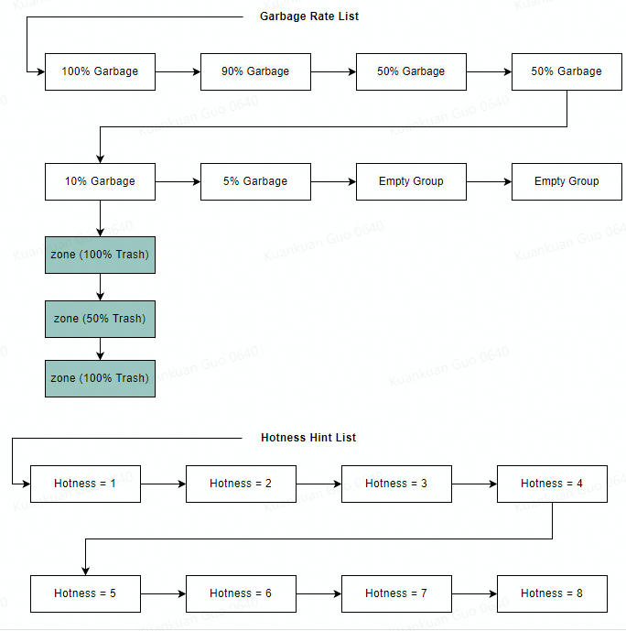
3. Solution - Ideas
Hotness Aware GC
- We select target Zone & ZoneGroup based on its garbage rate
- But of course we should place data into the same zone group based on their hotness tag (smaller hotness diff means their lifetime is closer)
QLC Compatible
- Tradtional RocksDB-like storage engine couldn’t use QLC SSD directly, because disk IO is random write, not strictly append only
Others (Future work)
- Cache policy aware GC
- Global GC & Data Placement across 8 ~ 16 disk on local server
......

Slide 8
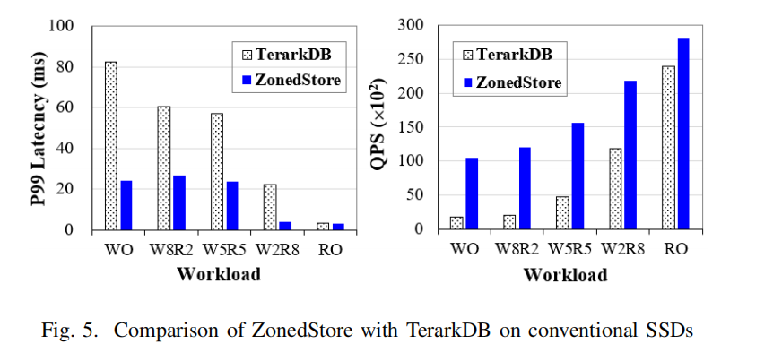
4. Benchmarks
 | TerarkDB (Conv SSD) | ZonedStore (Conv SSD) | ZonedStore (ZNS SSD)
MB/s | 216 | 699 | 813
P50(ms) | 1.57 | 1.23 | 1.18
P99(ms) | 7.2 | 3.59 | 3.33
QPS | 2270 | 7338 | 8535
We benchmarked ZonedStore & TerarkDB on Conventional SSD, the result shows the new design has significant improvements
Workload:
- Preload 600GB, then write another 200GB
- Value size: 100KB
- Cache limit: 600GB (eviction trigger size)
We also benchmarked ZonedStore under ZNS device, it show on ZNS device the QPS & throughput could be even better
Workload:
- Read: Write = 50:50
- Preload 600GB, then write another 200GB
- Value size: 100KB
- Cache Limit: 600GB (eviction trigger size)

Slide 9
5. Conclusion & QA
Zoned devices is super fit to cache systems
- Zoned devices enables user controled GC which could let us get more stable performance
- And more importantly we could almost use up the disk space if neccessary
- Data loss in a cache system is not un-accpetable, for most cases
Write amplification causes too much problems
- A lot of existing performance issues are caused be write amplifications
- including filesystem, lsm-tree, network...

